Slide 1
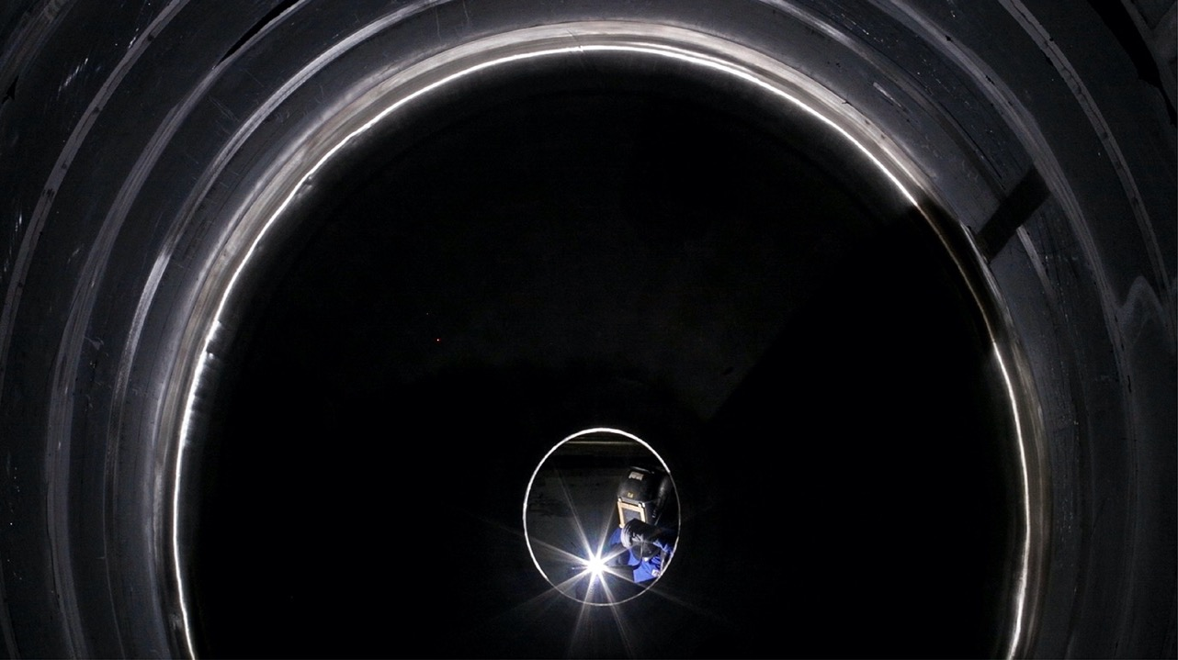
AIM Engineers India Pvt Ltd
Home
About Us
Facility
Portfolio
Clientele
AIM
E N G I N E E R S
I N D I A P R I V A T E L I M I T E D
HEAD OFFICE:
Plot No. PAP K 80 Phase II MIDC ,
Opp. Schindler Company, Chakan Pune, India- 410501
Website: www.aimengipl.com
Email: sales@aimengipl.com

Slide 2
Emergency Evacuation Plan
सुरक्षित कार्य है कर्त्तव्य हमारा | सुरक्षित जीवन से जुड़ा है परिवार सारा ||

Slide 3
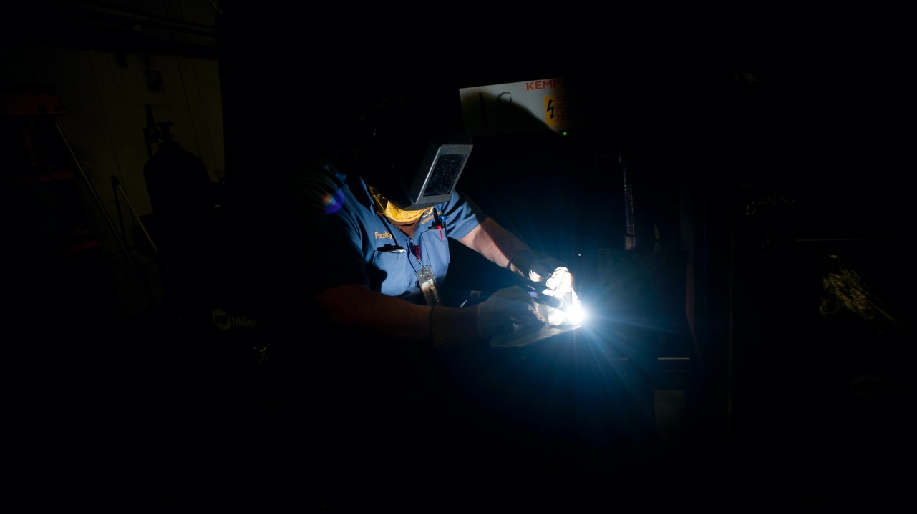
AIM Engineers India Pvt Ltd
Exit
Home
About Us
Facility
Portfolio
Clientele
MISION:
IMPROVING LIFE OF EVERYONE AROUND US By adopting the world class work ethics, by raising the standards & improving the culture of Indian industries to the level of developed countries, so India can Get Ahead and Stay Ahead.
VISION 2030:
AEIPL is now a HAPPY FAMILY of 1000 PRODUCTIVE, COMMITTED & ROLE MODEL Team Members, and is the benchmark for the whole engineering industry in India.
Core Values:
CONTINUOUS LEARNING
CUSTOMER FOCUS
CHALLENGING THE STATUS QUO
THINKING BIG

Slide 4
AIM Engineers India Pvt Ltd
Exit
Home
About Us
Facility
Portfolio
Clientele
Incorporated in 2017
Expertise in manufacturing of Stainless Steel and Carbon Steel equipment's required for Breweries, Pharma, Chemical, Food, Mining and Construction industries
We have very good experience in manufacturing of Stainless steel equipment's such as Fermenter, Heat Exchangers, Calendria, Reactors, Deodorizer, Scrubber, Bleacher, Limpet and Laser welded Jacket vessels, Unitanks, BBT, Brew House Kettles, Heater equipment's for edible oils, etc.
We have also gained Specialty in Mining and construction equipment's such as Hoppers, Conveyer, Stone crusher frames, VSI Crusher, HSI Crusher, Chutes, Rotors and Structures.
Our Defence portfolio includes structures for Missile Launching System(MLS) for Airforce and Army, Pinaka MBRL.

Slide 5
AIM Engineers India Pvt Ltd
Exit
Home
About Us
Facility
Portfolio
Clientele
Capacity | 200 Tons/month
Project equipment Fabrication – pressure vessel, heat exchanger, column etc. | 50
Structural work & heavy equipment fabrication work for Mining And Construction Equipment Division. | 150
Cranes | 10 Nos
10 Tons | 7
5 Tons | 3
Total No of Employees | 130 Nos
Engineers | 25
Skilled Labour | 60
Unskilled Labour | 35
Others | 10
Total Plant Area | 10740 SQM
Area Under Crane | 4830
Open Area | 5910
Plasma Cutting :
3m X 12.5m SS – 50mm Thk, CS – 250mm Thk
2) Paint Booth – 4m X 4M X 15M long
3) Shot Blasting Booth – 4m X 4M X 15M long

Slide 6
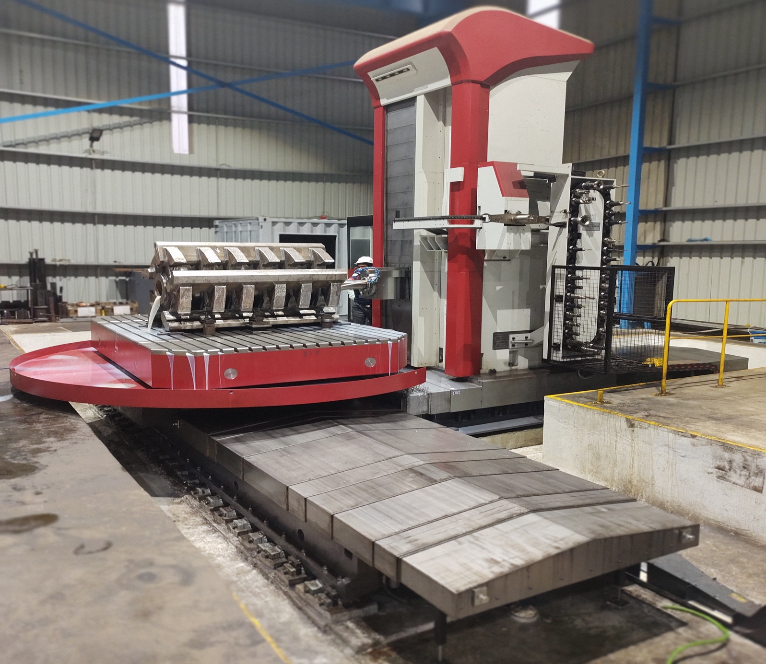
AIM Engineers India Pvt Ltd
Exit
Home
About Us
Facility
Portfolio
Clientele
FERMAT MAKE HMC
SIZE
X-6100mm, Y-3000mm, Z- 2500mm,
SPINDLE DIA- 150mm
Ram(V Travel) - 700 mm
SPINDLE STROKE(W travel) – 850mm,
ROTARY TABLE SIZE 2500 X 3500mm
LOADING CAP: 40 TON
CNC Control – Heidenhain TNC 640
Touch Probe – Heidenhain TS460

Slide 7

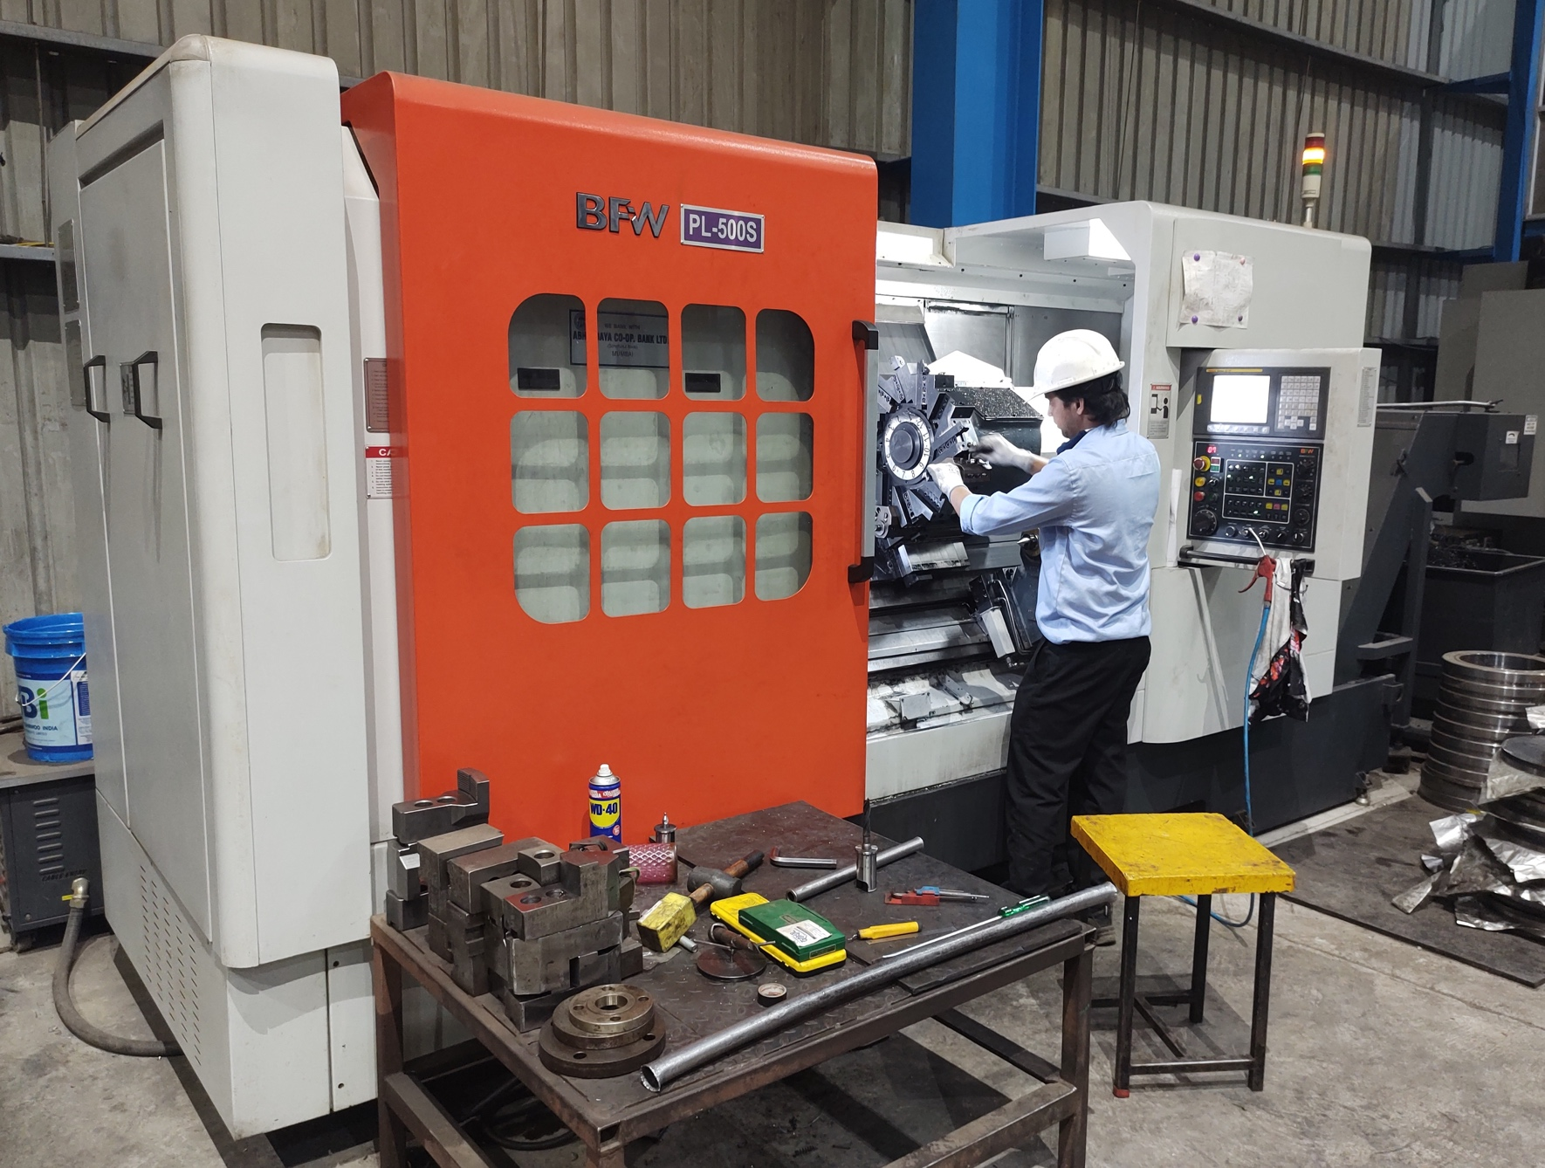
AIM Engineers India Pvt Ltd
Exit
Home
About Us
Facility
Portfolio
Clientele
BFW make CNC Lathe
Length Between Center 1000mm
Dia - 550mm
Chuck Dia - 400mm

Slide 8
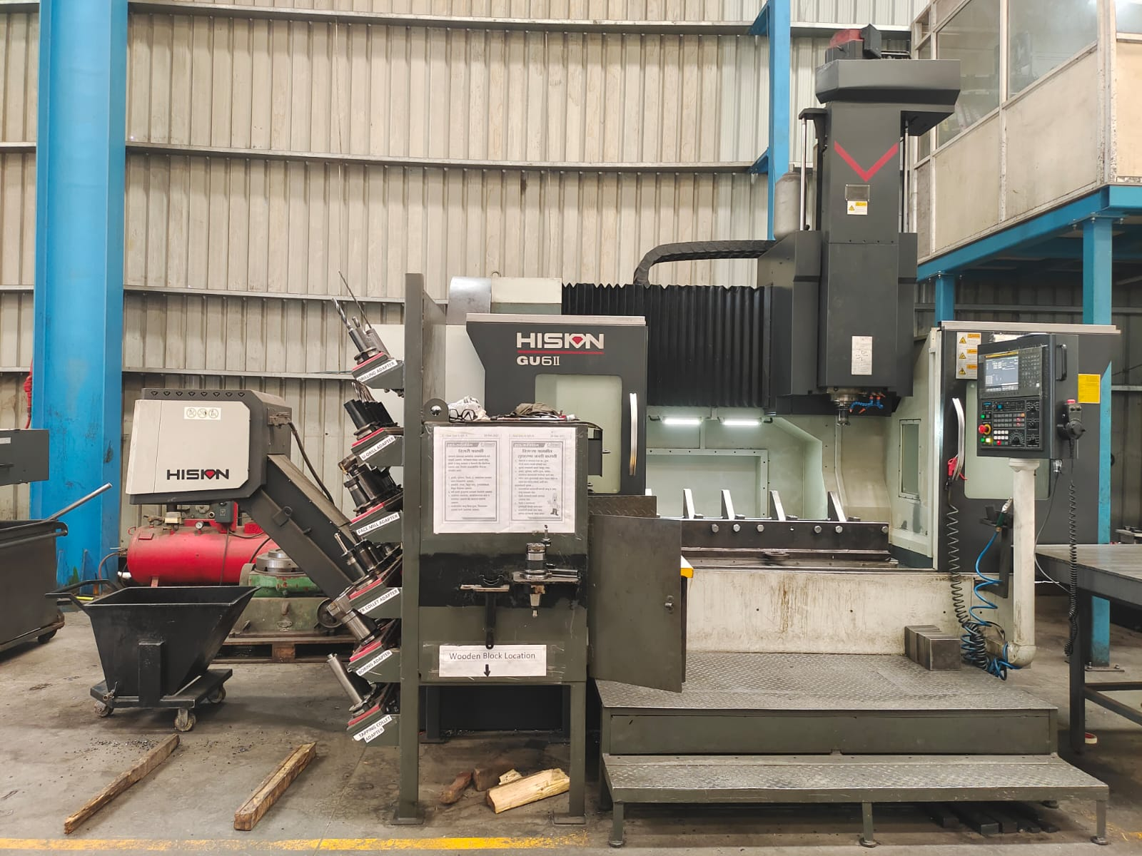
AIM Engineers India Pvt Ltd
Exit
Home
About Us
Facility
Portfolio
Clientele
HISION make VMC Model - GU6II
Size:
X-1500mm Y-850mm Z-700mm,
Table – 1500 mm X 850 mm With ATC and CTS

Slide 9
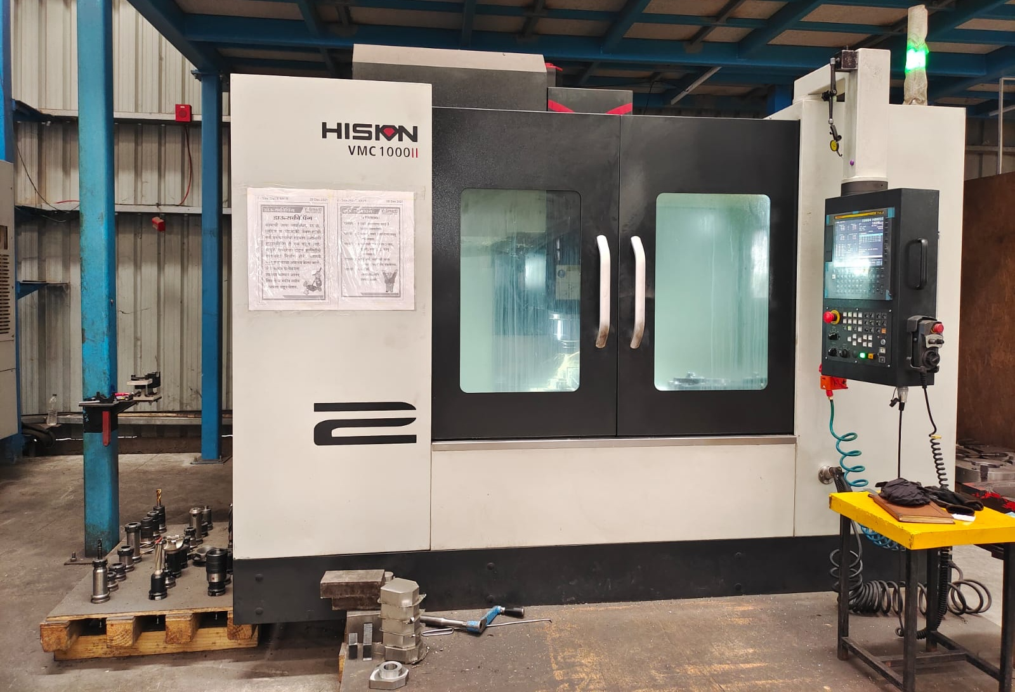
AIM Engineers India Pvt Ltd
Exit
Home
About Us
Facility
Portfolio
Clientele
HISION make VMC Model – 1000II
Size:
X-990mm Y-600mm Z-600mm,
Table – 1100 mm X 600 mm With ATC and CTS

Slide 10
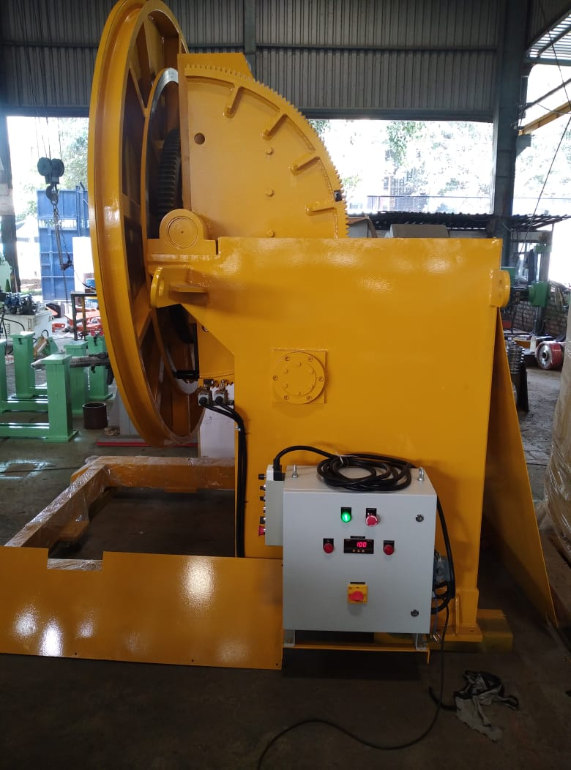
AIM Engineers India Pvt Ltd
Exit
Home
About Us
Facility
Portfolio
Clientele
1) Motorized Welding Positioner:
Dia – 2.5 mtrs
Load – 3 Ton
Rotation – 0 to 90 deg & 360 deg
2) Motorized Welding Positioner:
Dia – 800 mm
Load – 700 kgs.
Rotation – 0 to 90 deg & 360 deg

Slide 11
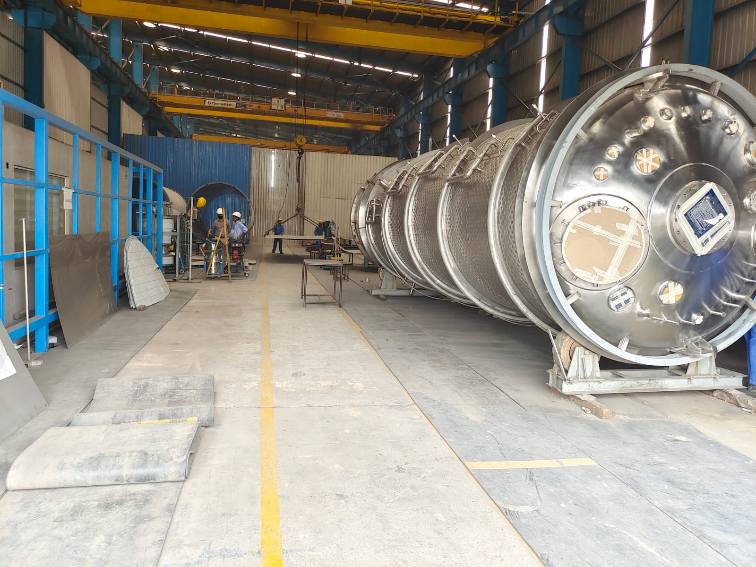
AIM Engineers India Pvt Ltd
Exit
Home
About Us
Facility
Portfolio
Clientele

Slide 12
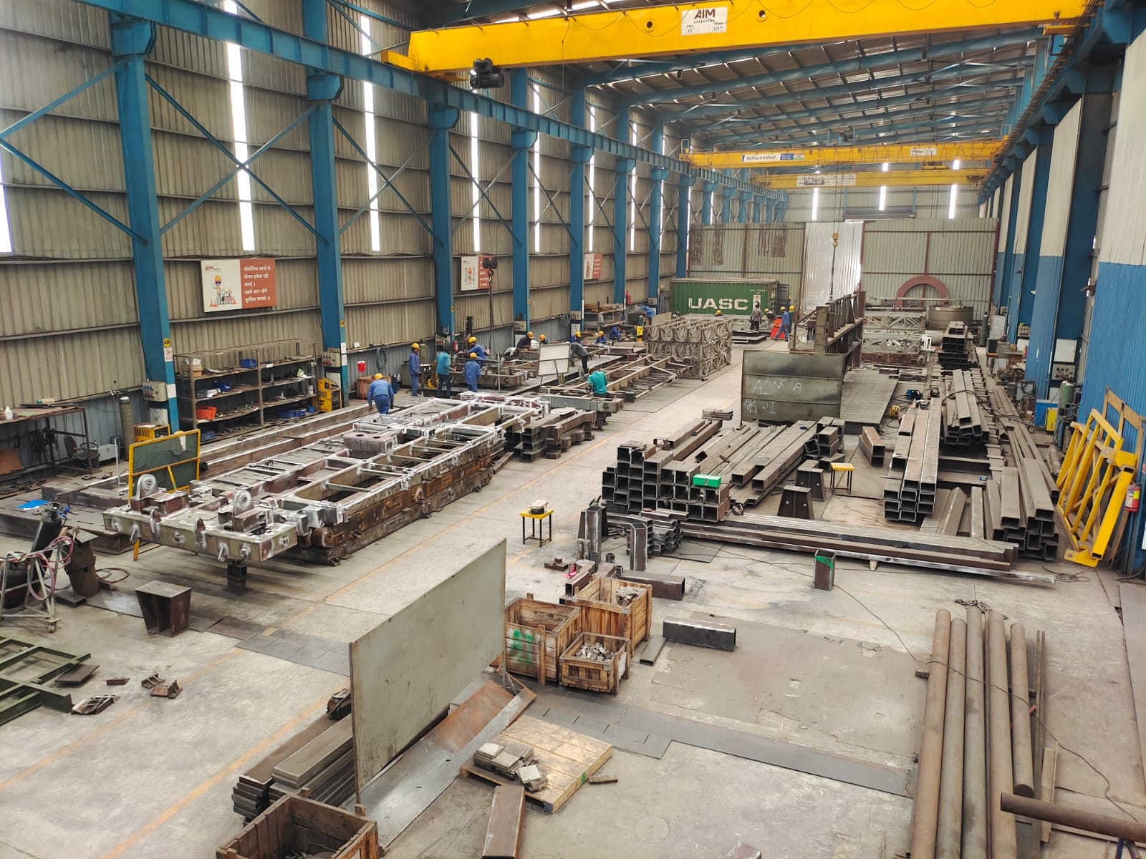
AIM Engineers India Pvt Ltd
Exit
Home
About Us
Facility
Portfolio
Clientele

Slide 13
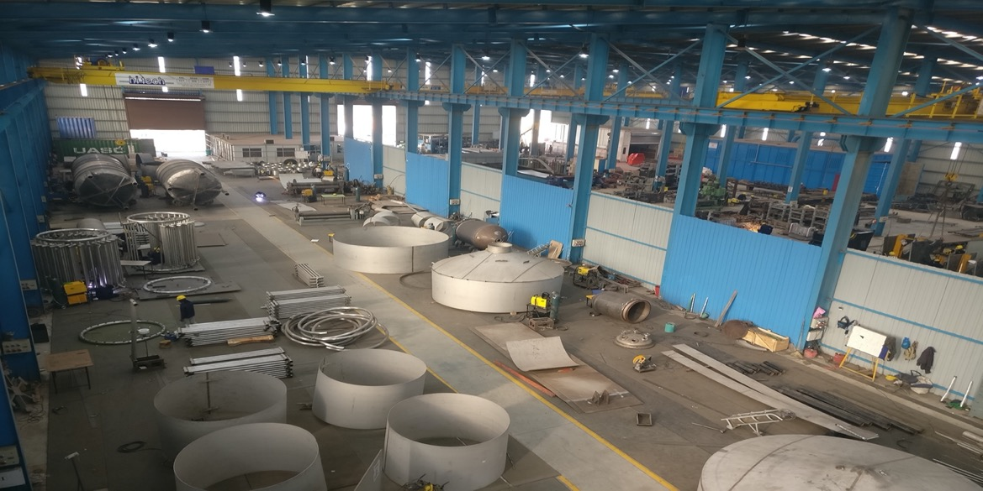
AIM Engineers India Pvt Ltd
Exit
Home
About Us
Facility
Portfolio
Clientele

Slide 14
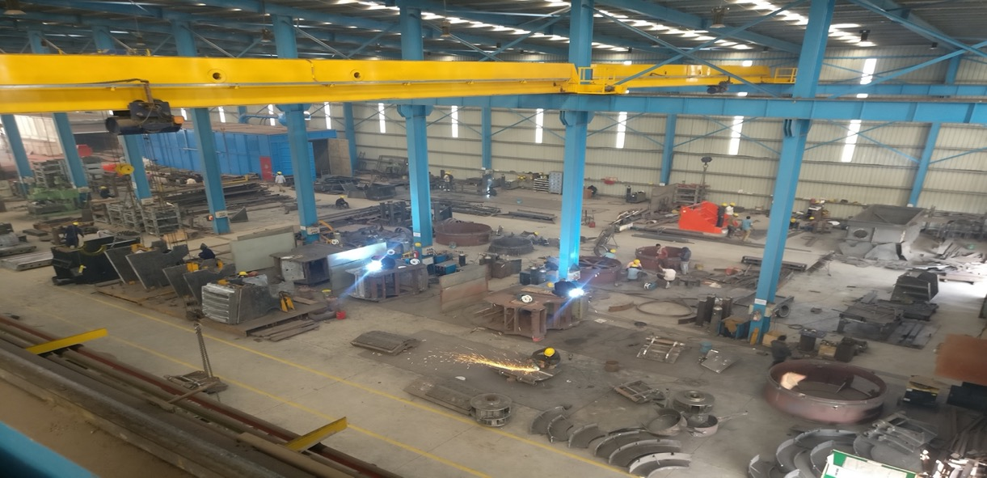
AIM Engineers India Pvt Ltd
Exit
Home
About Us
Facility
Portfolio
Clientele

Slide 15
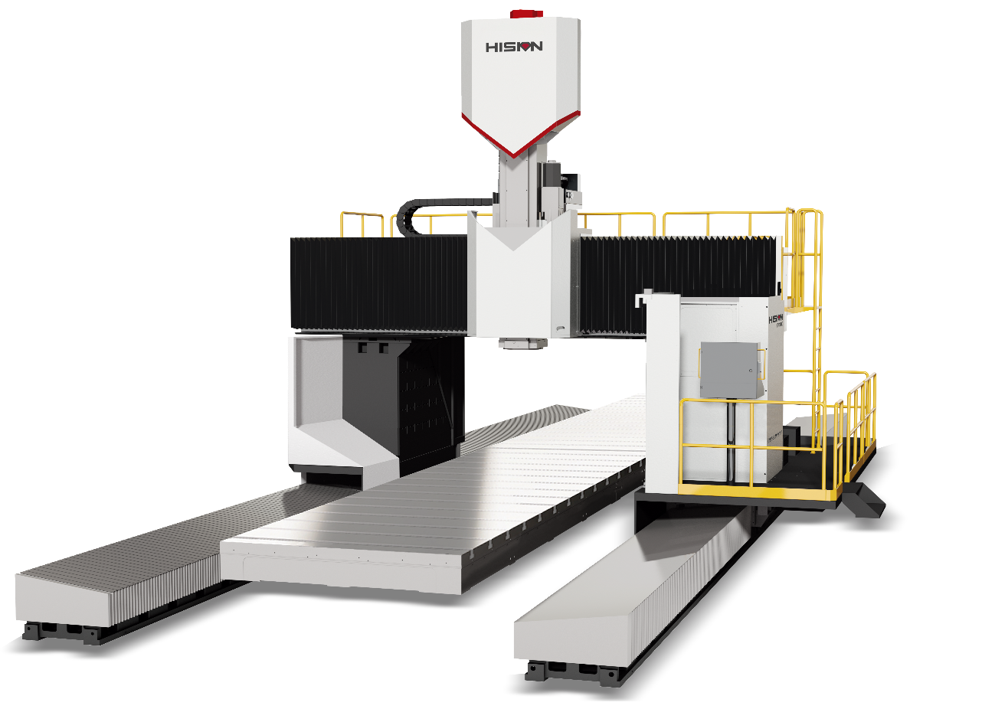
AIM Engineers India Pvt Ltd
Exit
Home
About Us
Facility
Portfolio
Clientele
FY 22-23 Expansion Plan:
HISION MAKE VMC
SIZE
X-9000mm, Y-3600mm, Z- 1250mm,
Spindle nose to table surface – 150mm to 1400mm
CNC Control – Siemens 840Dsl
Table Size – 2500mm x 8000mm
- Commissioning will be Completed by Jan 2023

Slide 16
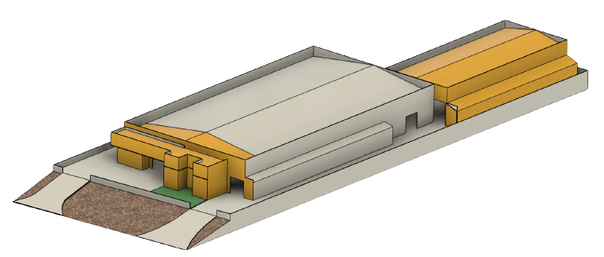
AIM Engineers India Pvt Ltd
Exit
Home
About Us
Facility
Portfolio
Clientele
FY 22-23 Expansion Plan:
4830 Sq Mtrs
Existing Factory
3000 Sq Mtrs
Factory Expansion
720 Sq Mtrs
Factory Expansion
1000 Sq Mtrs
Office Expansion
- Infra Expansion to be completed by end of 2023

Slide 17
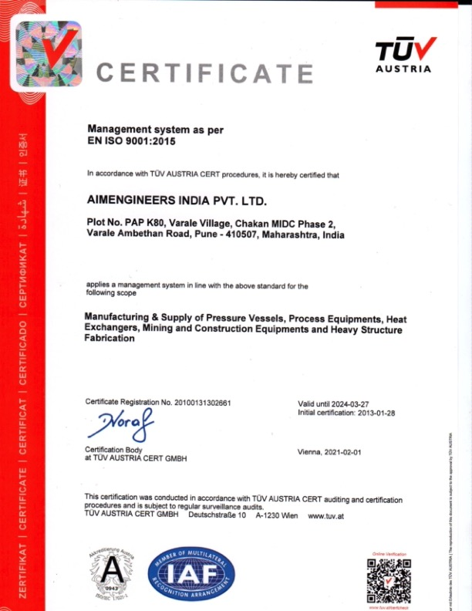
AIM Engineers India Pvt Ltd
Exit
Home
About Us
Facility
Portfolio
Clientele
* Implementation of IS3834-2 will be completed by Sep 2023
* Plan to Implement AS9100 by end of FY23-24

Slide 18
AIM Engineers India Pvt Ltd
Exit
Home
About Us
Facility
Portfolio
Clientele
- Quality Management System: ISO 9001:2015
- Division I – Mining & Construction
Product Range – Crusher Frame, Rotors, Conveyors, Chutes, Hopper, Platform
- Division II – Projects
Chemical Plant
Thermal Plant,
Sugar Factory
Refinery
Pharma, Dairy, Breweries
Petro Chemical
Storage Tanks
Pressure Vessels
Heat exchangers
Reactors
Defense
Structure for MBRL, Flat Bed, Container Lifting Lifting
- Division III – Refurbishment for Mining & Construction Equipments
- Inspection Agencies:
TUV, BV, AKPG, IQS, QUEST, LLOYDS, SAB - KCPC

Slide 19
AIM Engineers India Pvt Ltd
Exit
Home
About Us
Facility
Portfolio
Clientele
Past Track Record

Slide 20
AIM Engineers India Pvt Ltd
Exit
Home
About Us
Facility
Portfolio
Clientele
Customer | End Customer | Products | Year | Detail engineering | Manufacturing | No of equipment’s | MOC | Project total weight in Tons
Alfa Laval | Vedanta Alumina | Calandria (Ref Pg 25) | 2010-2011 | No | Yes | 10 | SS304/Sa516 Gr 70 | 1300
Alfa Laval | Utkal | Heat exchangers | 2010-2011 | No | Yes | 4 | SS304/Sa516 Gr 70 | 120
Alfa Laval | Saba Chemical Malaysaia | Calandria (Ref Pg 26) | 2011-2012 | No | Yes | 4 | SS304/Sa516 Gr 70 | 240
Alfa Laval | CG brewery Nepal | Brew House equipment's( Mash Kettle, Wort kettle, Whirlpool, Wort holding tank. Lauter Tun, BBT, Wort Boiler, Fermenters) (Ref Pg 28) | 2017 - 2018 | Yes | Yes | 15 | SS304/ SS316 | 220
Alfa Laval | Biocon | Fermenters and Reactors for Pharma (Ref Pg 32) | 2021-2022 | Yes | Yes | 7 | SS304/ SS317 | 55
Alfa Laval | Edible oil Refineries | Heat exchangers for edible oil plant VHE/ FHE Products developed for first in India (Ref Pg 31) | 2017-2022 | No | Yes | 20 | SS304/ SS316 | 225
KCPC Japan | Nipro K1 | Reactors, Calandria, heat exchangers, Columns, Storage tanks, Separator’s (Ref Pg 20-24) | 2012-2013 | Yes | Yes | 27 | SS304/ SS316 | 75
KCPC Japan | Nipro K2 | Reactors, Calandria, heat exchangers, Columns, Storage tanks, Separator's (Ref Pg 20-24) | 2017-2018 | Yes | Yes | 57 | SS304/ SS316 | 150
KCPC Japan | Nipro K3 | Reactors, Calandria, heat exchangers, Columns, Storage tanks, Separator's (Ref Pg 20-24) | 2018-2019 | Yes | Yes | 14 | SS304/ SS316 | 35
UCC | UCC USA | Filter Separator’s for Ash Handling in Power Plants (Ref Pg 33) | 2016 | Yes | Yes | 2 | SA516/70 | 35
UCC | UCC Malaysia | Filter Separator’s for Ash Handling in Power Plants | 2019 | Yes | Yes | 2 | SA516/70 | 35
Nzoia Sugar Kenya | Nzoia Sugar | Calandria (Ref Pg 34) | 2015 | Yes | Yes | 1 | SS304/ MS | 25
Danieli | Danieli | Stacks Chimney and Structures | 2017 | No | Yes | 4 | IS 2062 | 75
Brew Force | Aether Brewery | BBT and Fermentrs For brewery plant (Ref Pg 29) | 2019 | Yes | Yes | 9 | SS304/SS316 | 130
Kristtor Vacuum | Kristtor Vacuum Qatar | Auto Clave for vaccum enprigmetion of Transfer coils (Ref Pg 35) | 2022 | Yes | Yes | 1 | SA516/70 | 50
Green Elephant | Volkswagan | Portable Biogas Plant for canten waste of Industires (Ref Pg 25) | 2012-2017 | Yes | Yes | 13 | IS 2062 | 195

Slide 21
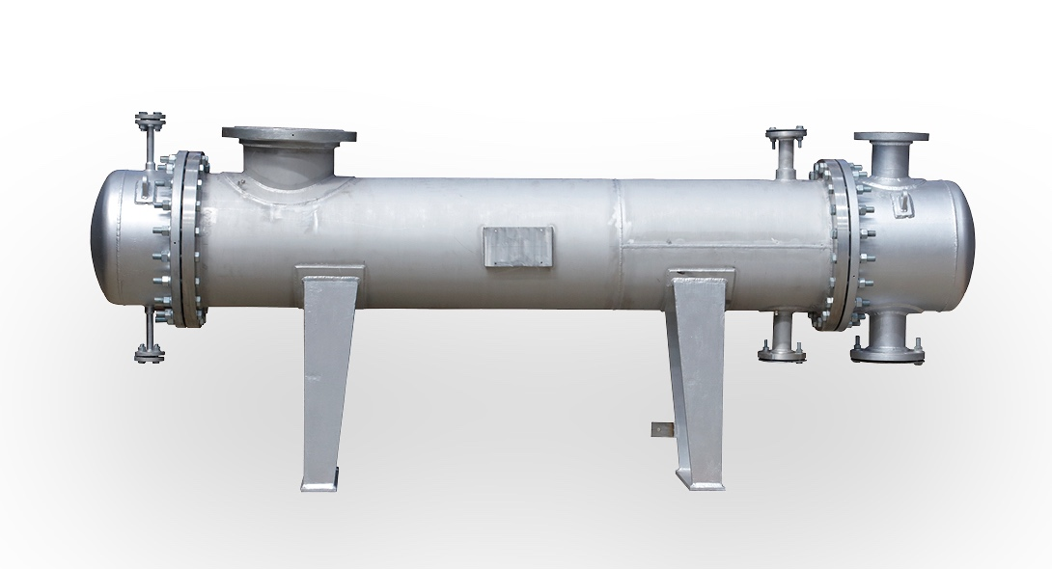
AIM Engineers India Pvt Ltd
Exit
Home
About Us
Facility
Portfolio
Clientele
Customer | End Customer | Product | Year | Detailed engineering | Manufacturing | No of Equipment's supplied | MOC | Total Project weight in Tons
KCPC Japan | Nipro Pharma K1,K2,K3,K4 | Heat Exchanger | 2012 - 2013 | Yes | Yes | 27 | SS304/SS316 | 75

Slide 22
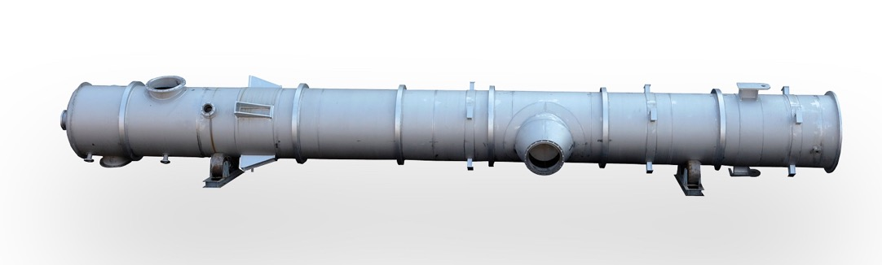
AIM Engineers India Pvt Ltd
Exit
Home
About Us
Facility
Portfolio
Clientele
Customer | End Customer | Product | Year | Detailed engineering | Manufacturing | No of Equipment's supplied | MOC | Total Project weight in Tons
KCPC Japan | Nipro Pharma K2 | Heat Exchanger | 2012 - 2013 | Yes | Yes | 57 | SS304/SS316 | 150

Slide 23
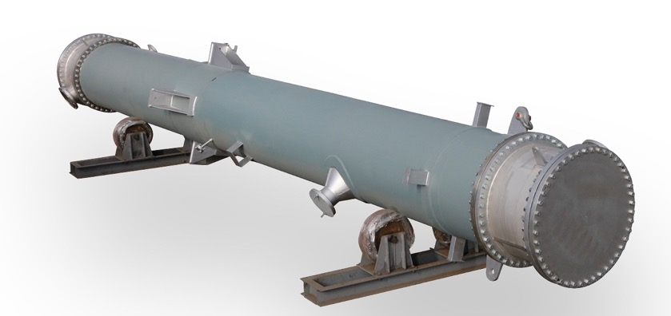
AIM Engineers India Pvt Ltd
Exit
Home
About Us
Facility
Portfolio
Clientele
Customer | End Customer | Product | Year | Detailed engineering | Manufacturing | No of Equipment's supplied | MOC | Total Project weight in Tons
KCPC Japan | Nipro Pharma K2 | Heat Exchanger | 2012 - 2013 | Yes | Yes | 57 | SS304/SS316 | 150

Slide 24
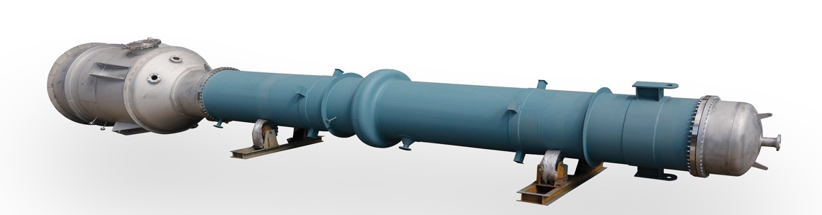
AIM Engineers India Pvt Ltd
Exit
Home
About Us
Facility
Portfolio
Clientele
Customer | End Customer | Product | Year | Detailed engineering | Manufacturing | No of Equipment's supplied | MOC | Total Project weight in Tons
KCPC Japan | Nipro Pharma K2 | Calandria | 2012 - 2013 | Yes | Yes | 57 | SS304/SS316 | 150

Slide 25
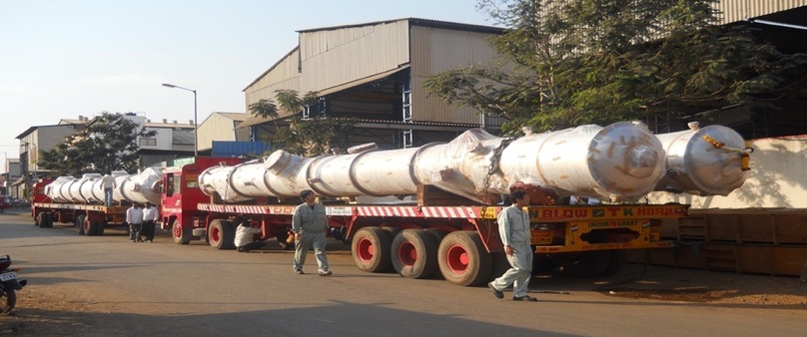
AIM Engineers India Pvt Ltd
Exit
Home
About Us
Facility
Portfolio
Clientele
Customer | End Customer | Product | Year | Detailed engineering | Manufacturing | No of Equipment's supplied | MOC | Total Project weight in Tons
KCPC Japan | Nipro Pharma K1 | Calandria | 2012 - 2013 | Yes | Yes | 27 | SS304/SS316 | 75

Slide 26
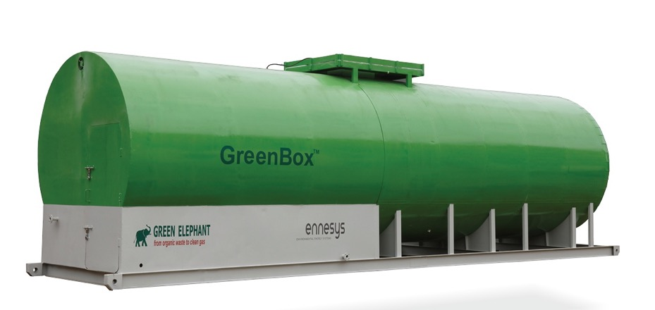
AIM Engineers India Pvt Ltd
Exit
Home
About Us
Facility
Portfolio
Clientele
Customer | End Customer | Product | Year | Detailed engineering | Manufacturing | No of Equipment's supplied | MOC | Total Project weight in Tons
Green Elephant | Volkswagen | Portable Biogas Plant | 2012 - 2017 | Yes | Yes | 13 | IS2062 | 195

Slide 27
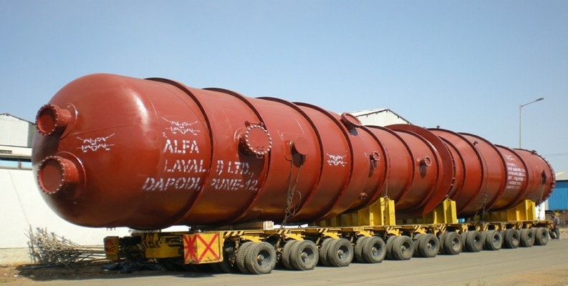
AIM Engineers India Pvt Ltd
Exit
Home
About Us
Facility
Portfolio
Clientele
Customer | End Customer | Product | Year | Detailed engineering | Manufacturing | No of Equipment's supplied | MOC | Total Project weight in Tons
Alfa Laval | Vedanta Aluminium | Calandria | 2010 - 2011 | No | Yes | 10 | SS304/SA516 Gr70 | 1300

Slide 28
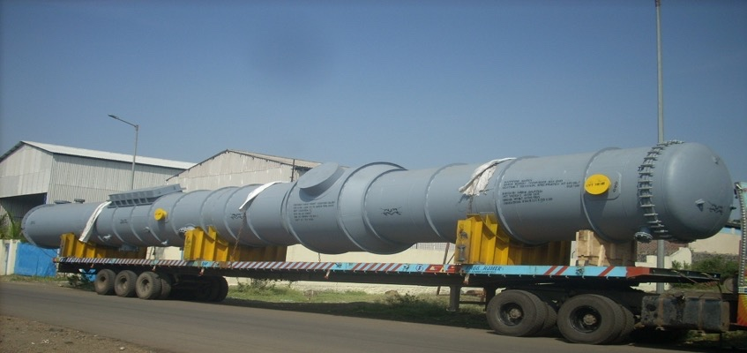
AIM Engineers India Pvt Ltd
Exit
Home
About Us
Facility
Portfolio
Clientele
Customer | End Customer | Product | Year | Detailed engineering | Manufacturing | No of Equipment's supplied | MOC | Total Project weight in Tons
Alfa Laval | Saba Chemicals Malaysia | Calandria | 2011 - 2012 | No | Yes | 4 | SS304/SA516 Gr70 | 240

Slide 29
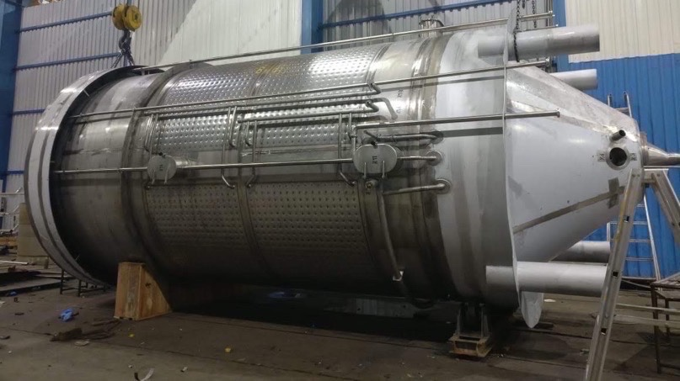
AIM Engineers India Pvt Ltd
Exit
Home
About Us
Facility
Portfolio
Clientele
Customer | End Customer | Product | Year | Detailed engineering | Manufacturing | No of Equipment's supplied | MOC | Total Project weight in Tons
Alfa Laval | CG Breweries Nepal | Unitank | 2017 - 2018 | Yes | Yes | 15 | SS304/SS316 | 220

Slide 30
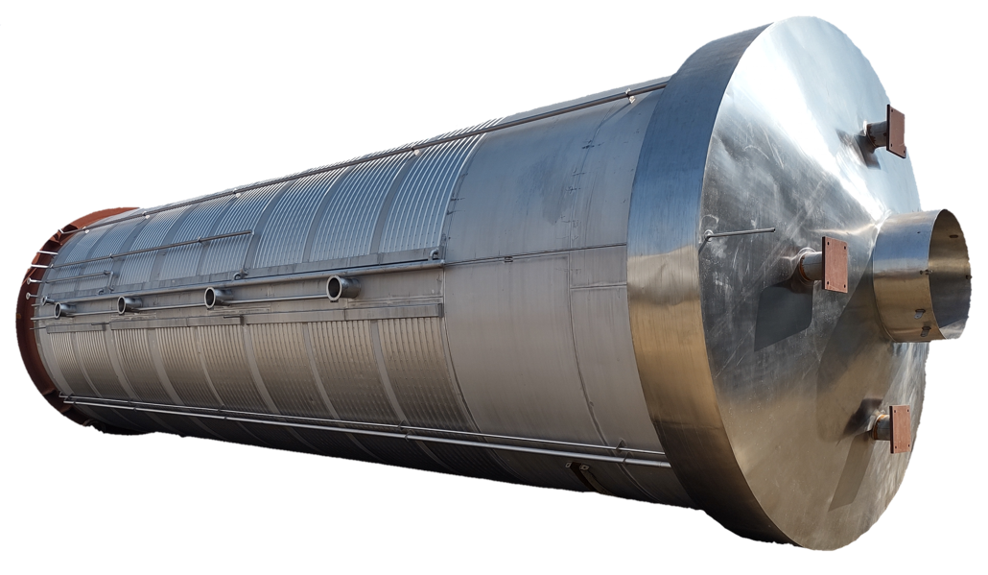
AIM Engineers India Pvt Ltd
Exit
Home
About Us
Facility
Portfolio
Clientele
Customer | End Customer | Product | Year | Detailed engineering | Manufacturing | No of Equipment's supplied | MOC | Total Project weight in Tons
Brewforce | Aether Breweries | Fermenter | 2019 | Yes | Yes | 9 | SS304/SS316 | 130

Slide 31
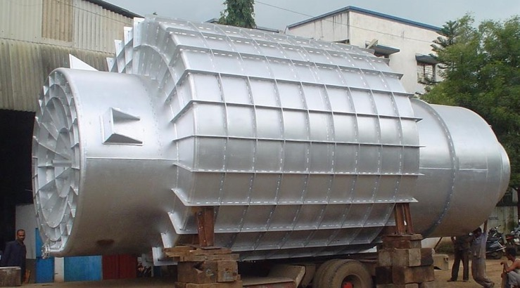
AIM Engineers India Pvt Ltd
Exit
Home
About Us
Facility
Portfolio
Clientele
Customer | End Customer | Product | Year | Detailed engineering | Manufacturing | No of Equipment's supplied | MOC | Total Project weight in Tons
Alfa Laval | Vedanta Aluminium | Vapor Seperator | 2010 – 2011 | Yes | Yes | 2 | SA516 Gr70 | 50

Slide 32
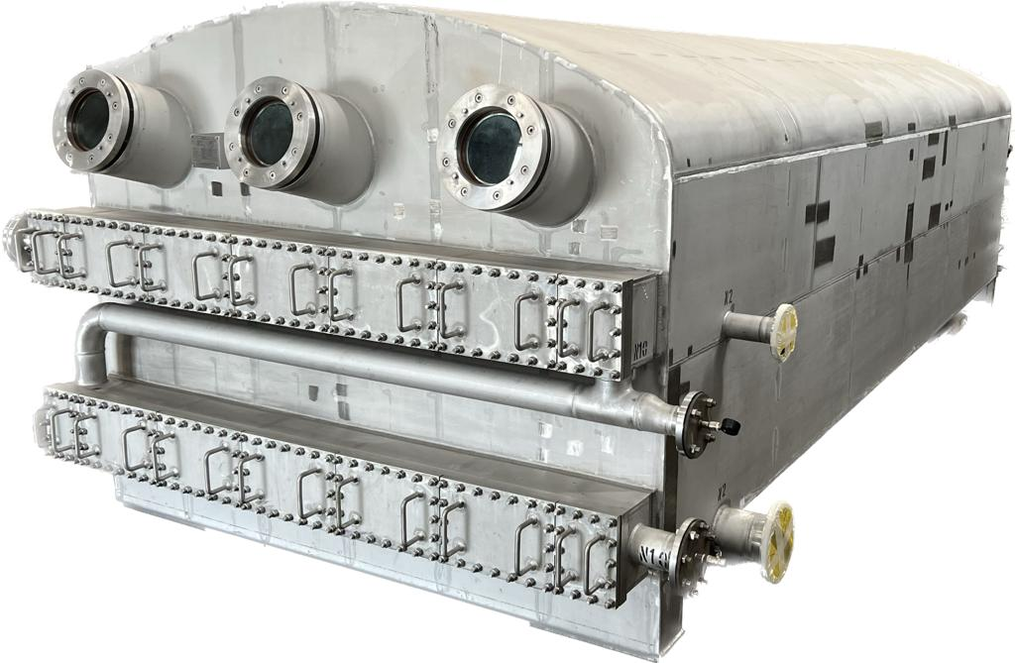
AIM Engineers India Pvt Ltd
Exit
Home
About Us
Facility
Portfolio
Clientele
Heat exchanger for edible oil plant VHE/ FHE
** Products developed for
first in India
Customer | End Customer | Product | Year | Detailed engineering | Manufacturing | No of Equipment's supplied | MOC | Total Project weight in Tons
Alfa Laval | Edible Oil Refineries | Heat Exchanger | 2017 – 2022 | No | Yes | 20 | SS304/SS316 | 225

Slide 33
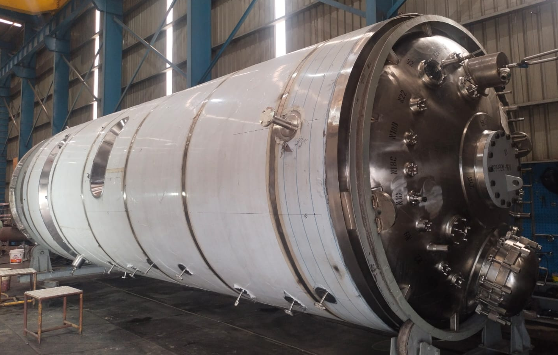
AIM Engineers India Pvt Ltd
Exit
Home
About Us
Facility
Portfolio
Clientele
Customer | End Customer | Product | Year | Detailed engineering | Manufacturing | No of Equipment's supplied | MOC | Total Project weight in Tons
Alfa Laval | Biocon Pharma | Fermenter/Reactor | 2021 – 2022 | Yes | Yes | 7 | SS304/SS316 | 55

Slide 34
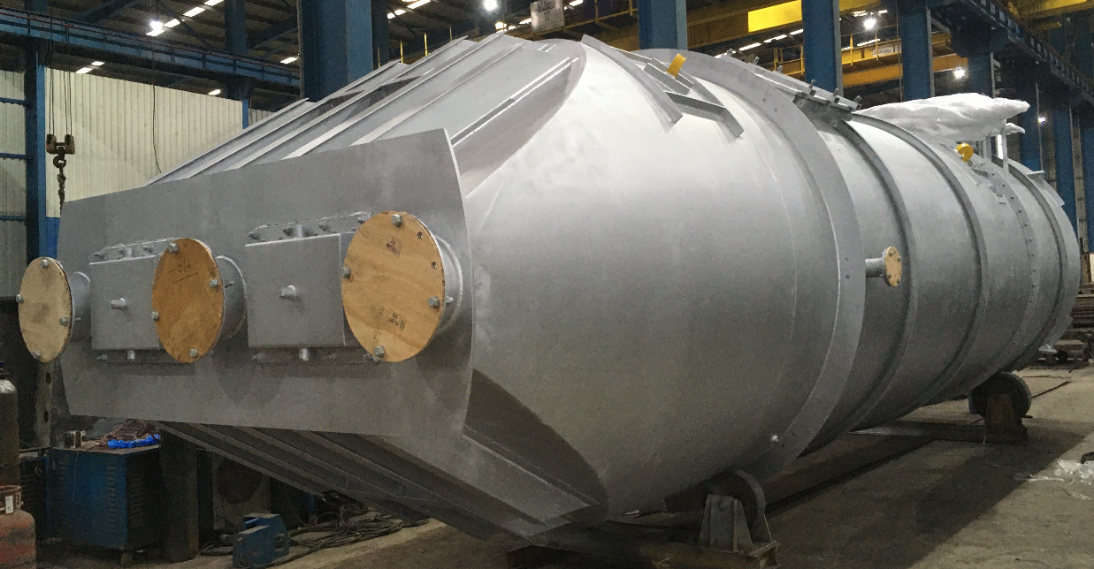
AIM Engineers India Pvt Ltd
Exit
Home
About Us
Facility
Portfolio
Clientele
Customer | End Customer | Product | Year | Detailed engineering | Manufacturing | No of Equipment's supplied | MOC | Total Project weight in Tons
UCC | Ash Handling Unit | Filter Separator | 2016 &2019 | Yes | Yes | 4 | SA516 Gr70 | 140

Slide 35
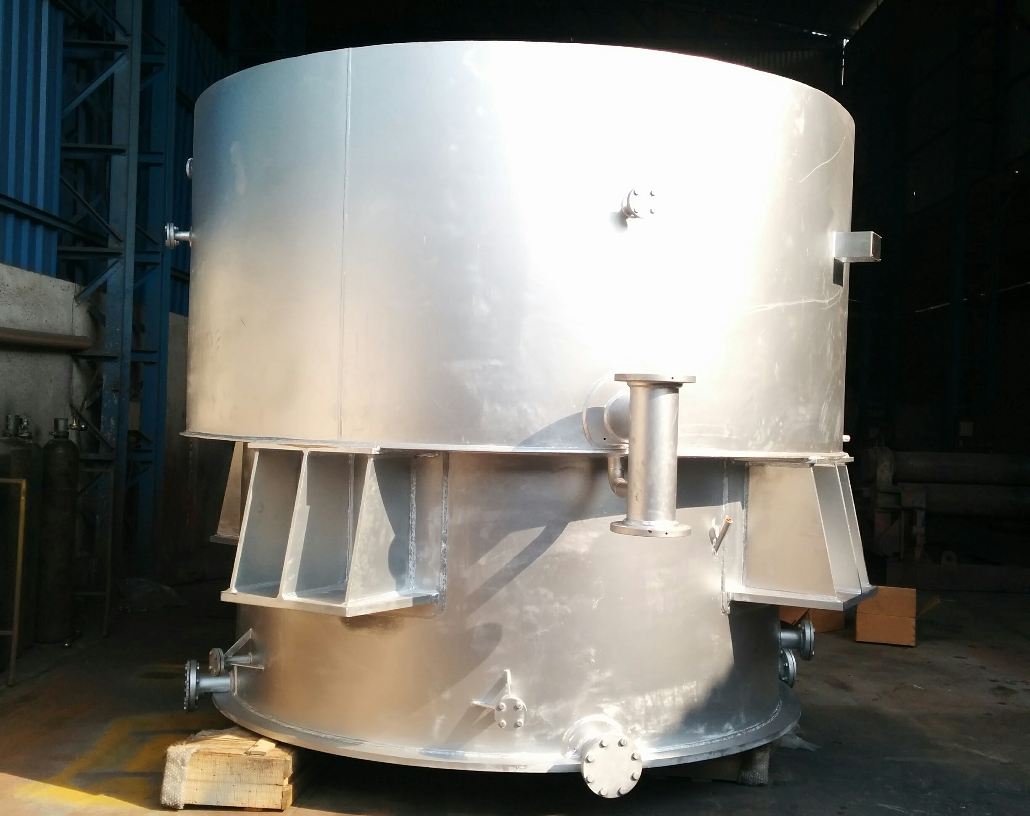
AIM Engineers India Pvt Ltd
Exit
Home
About Us
Facility
Portfolio
Clientele
Customer | End Customer | Product | Year | Detailed engineering | Manufacturing | No of Equipment's supplied | MOC | Total Project weight in Tons
Nzoia Sugar | Nzoia Sugar | Calandria | 2015 | Yes | Yes | 1 | SS304/MS | 25

Slide 36
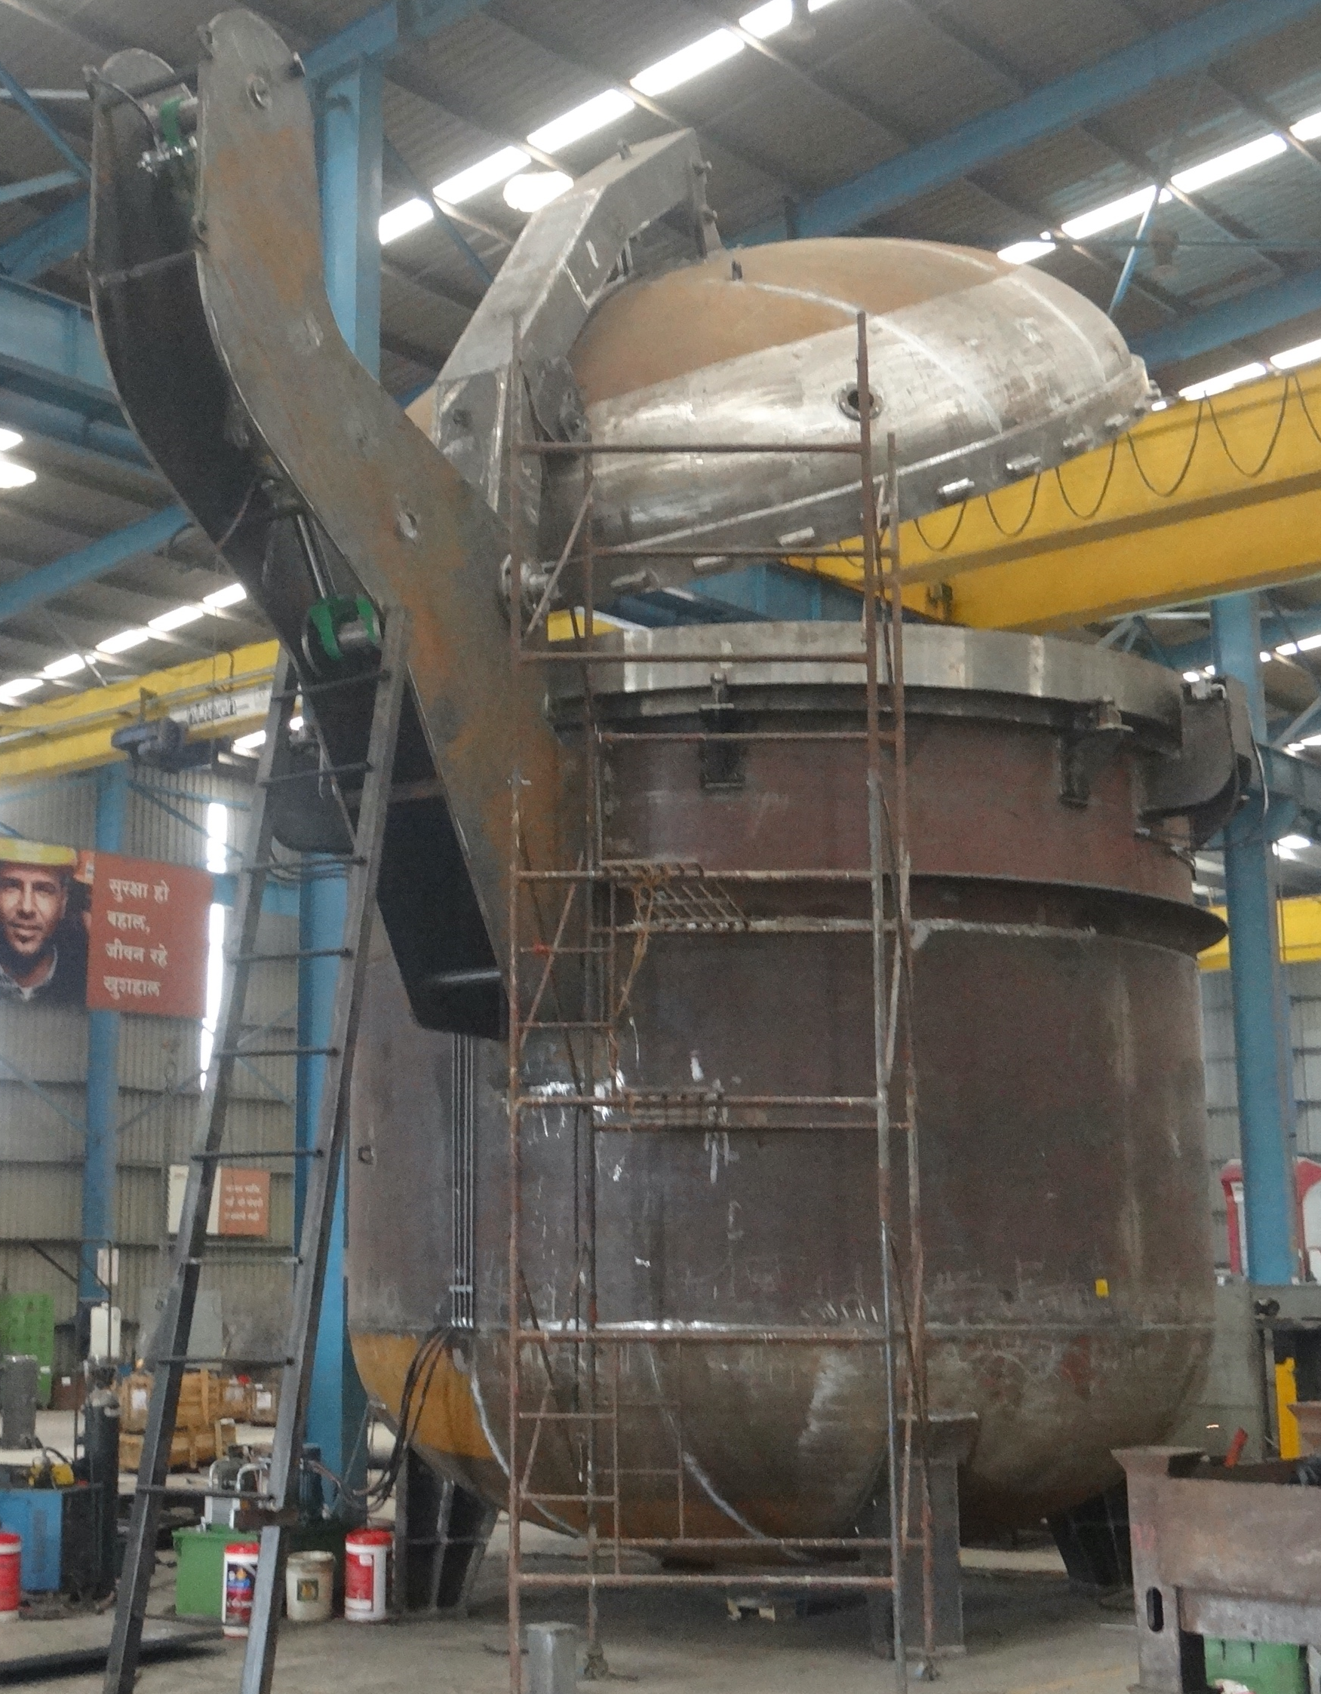
AIM Engineers India Pvt Ltd
Exit
Home
About Us
Facility
Portfolio
Clientele
Customer | End Customer | Product | Year | Detailed engineering | Manufacturing | No of Equipment's supplied | MOC | Total Project weight in Tons
Krissttor Vacuum | Krissttor Vacuum Qatar | Vacuum Chamber | 2022 | Yes | Yes | 1 | SA516 Gr70 | 50

Slide 37
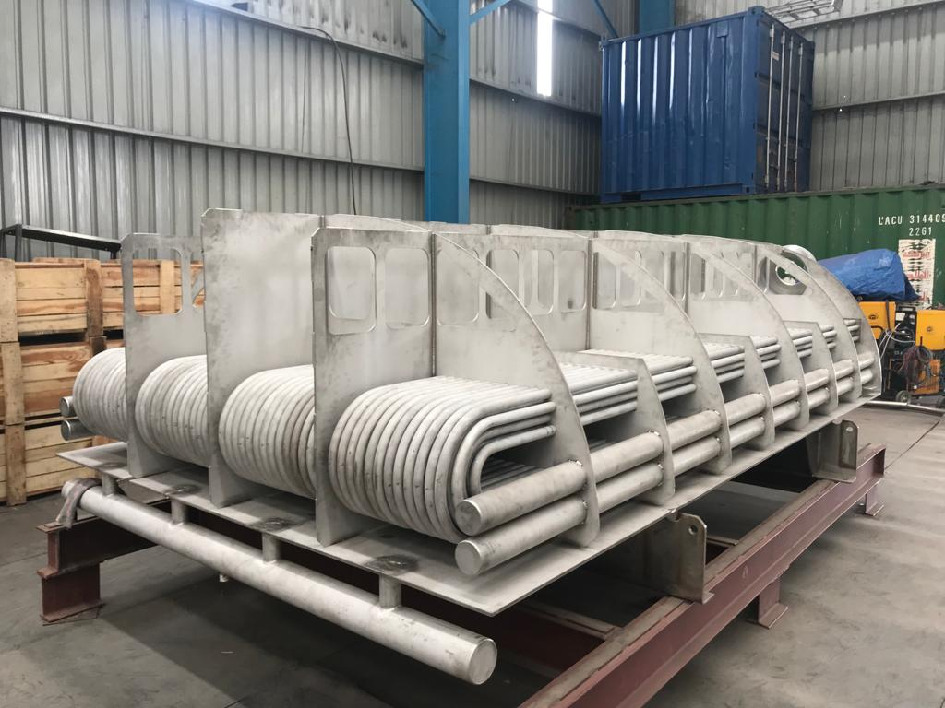
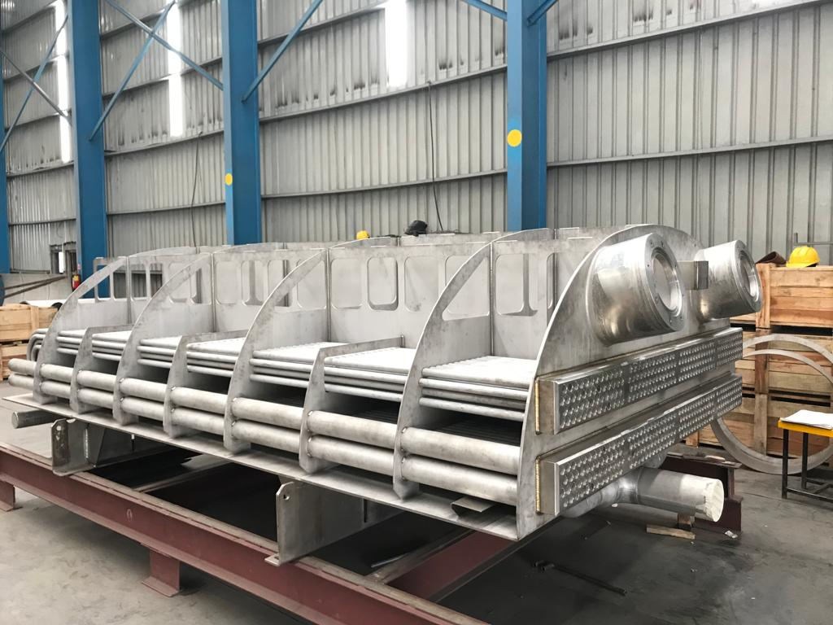
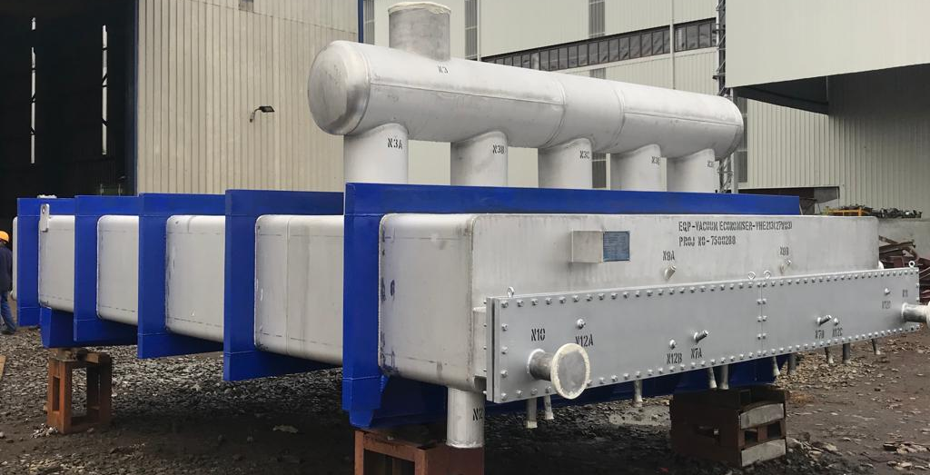
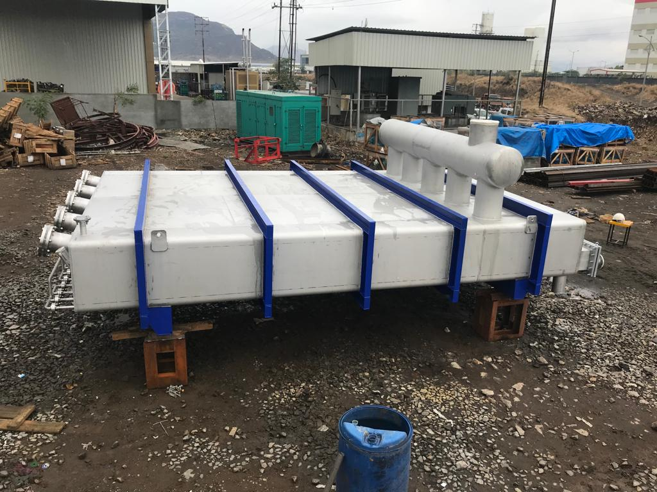
AIM Engineers India Pvt Ltd
Exit
Home
About Us
Facility
Portfolio
Clientele
Heat Exchangers

Slide 38
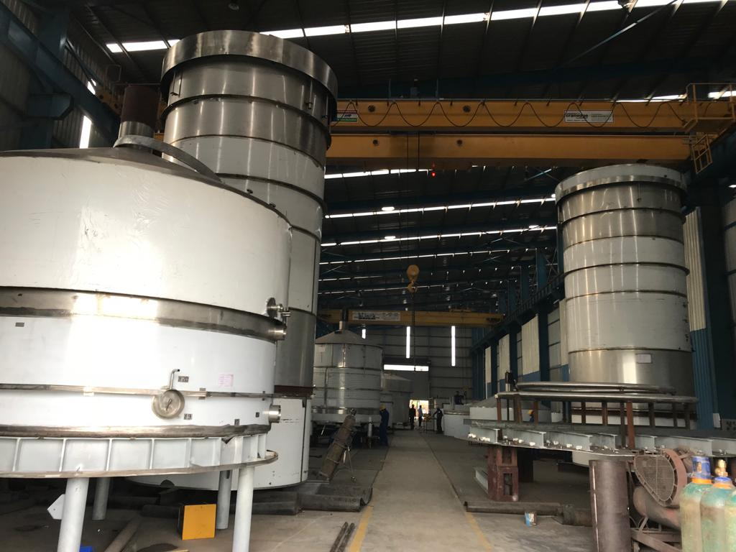
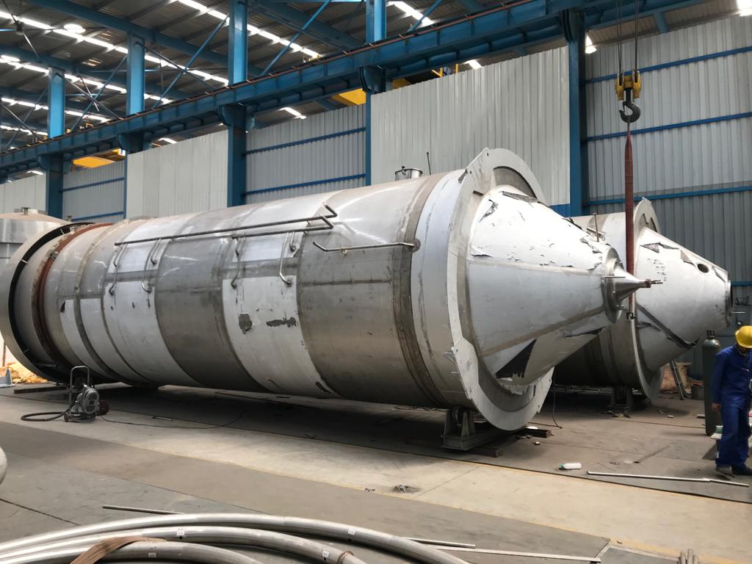
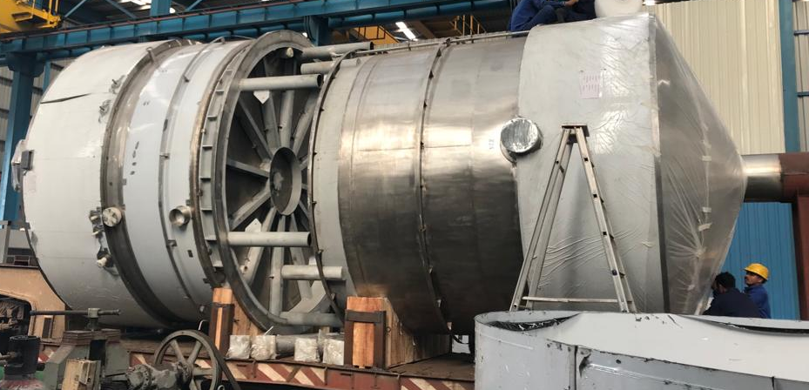
AIM Engineers India Pvt Ltd
Exit
Home
About Us
Facility
Portfolio
Clientele
Process Equipment’s

Slide 39

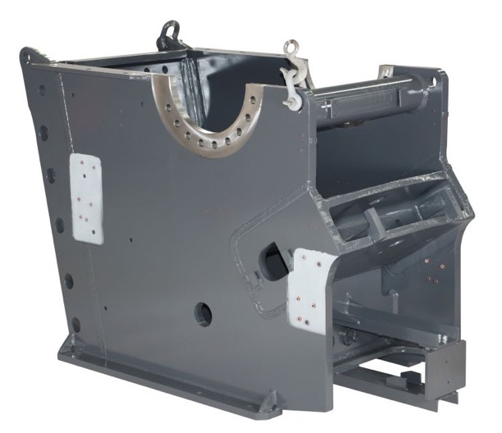
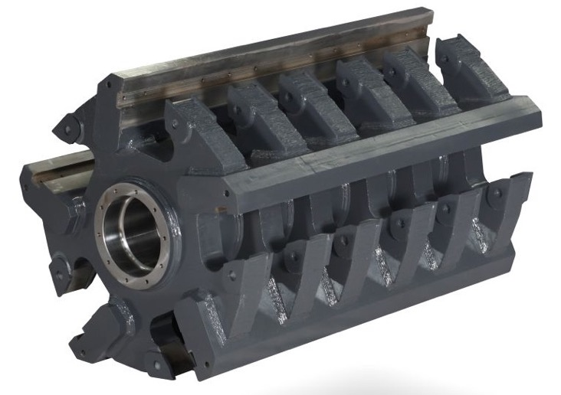
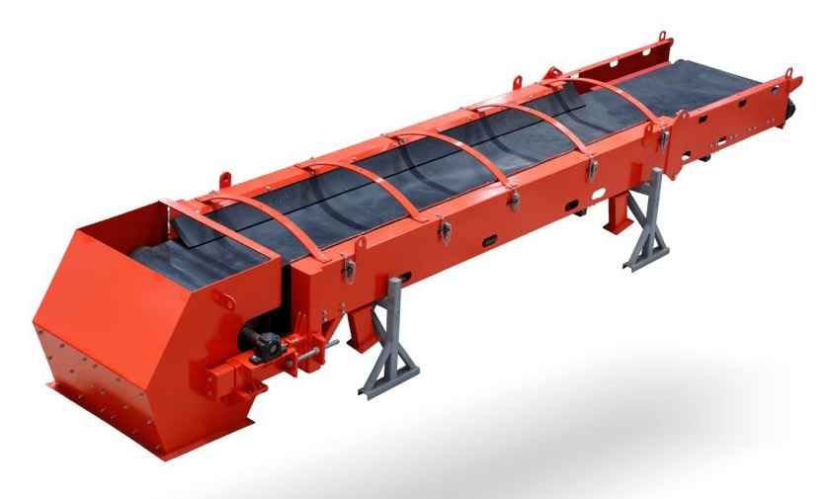
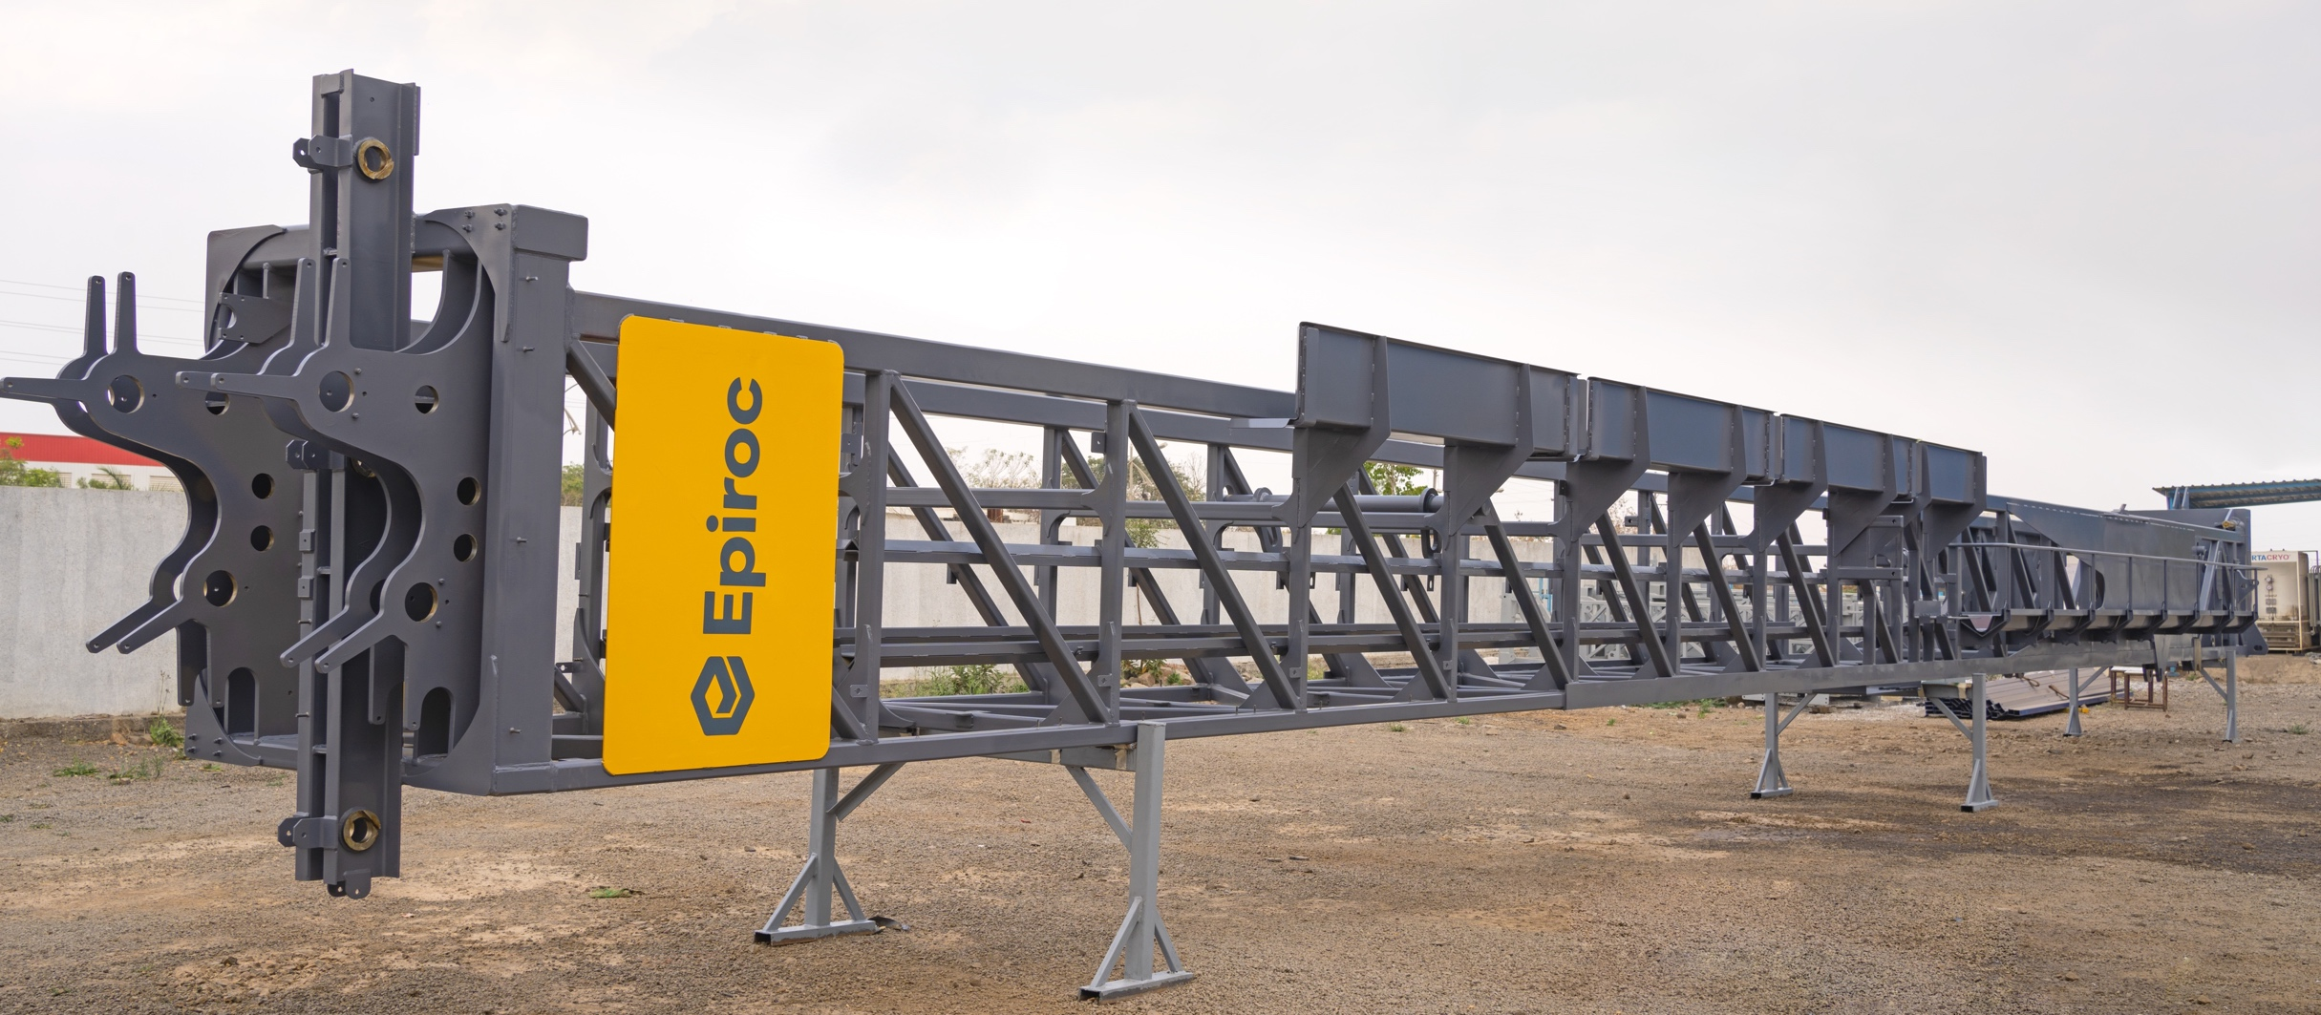
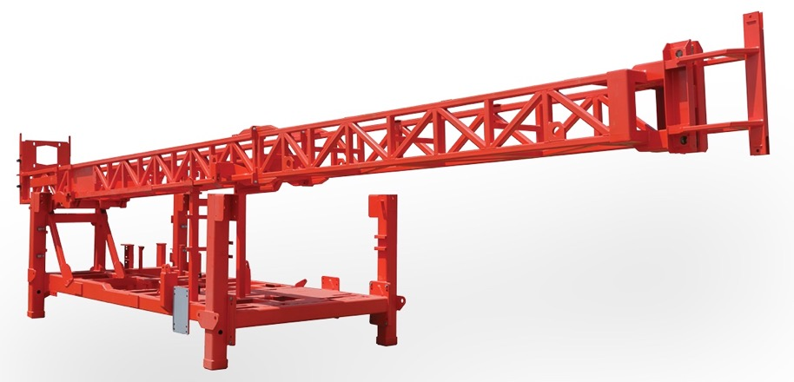
AIM Engineers India Pvt Ltd
Back
Exit
Home
About Us
Facility
Portfolio
Clientele
Mining & Construction Equipment’s

Slide 40
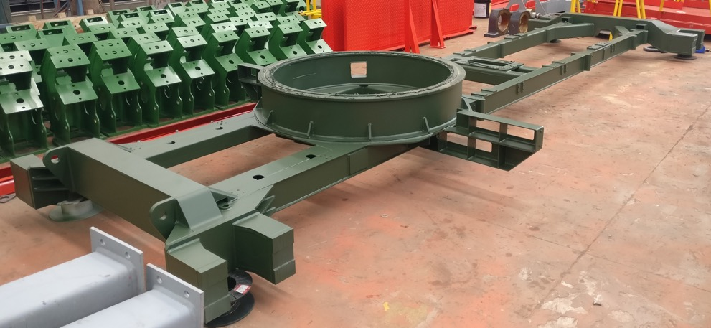
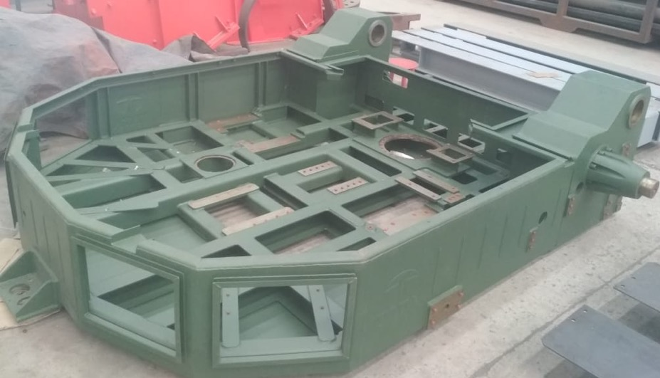
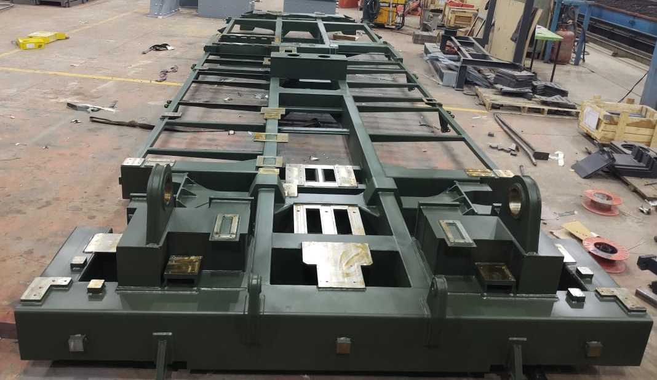
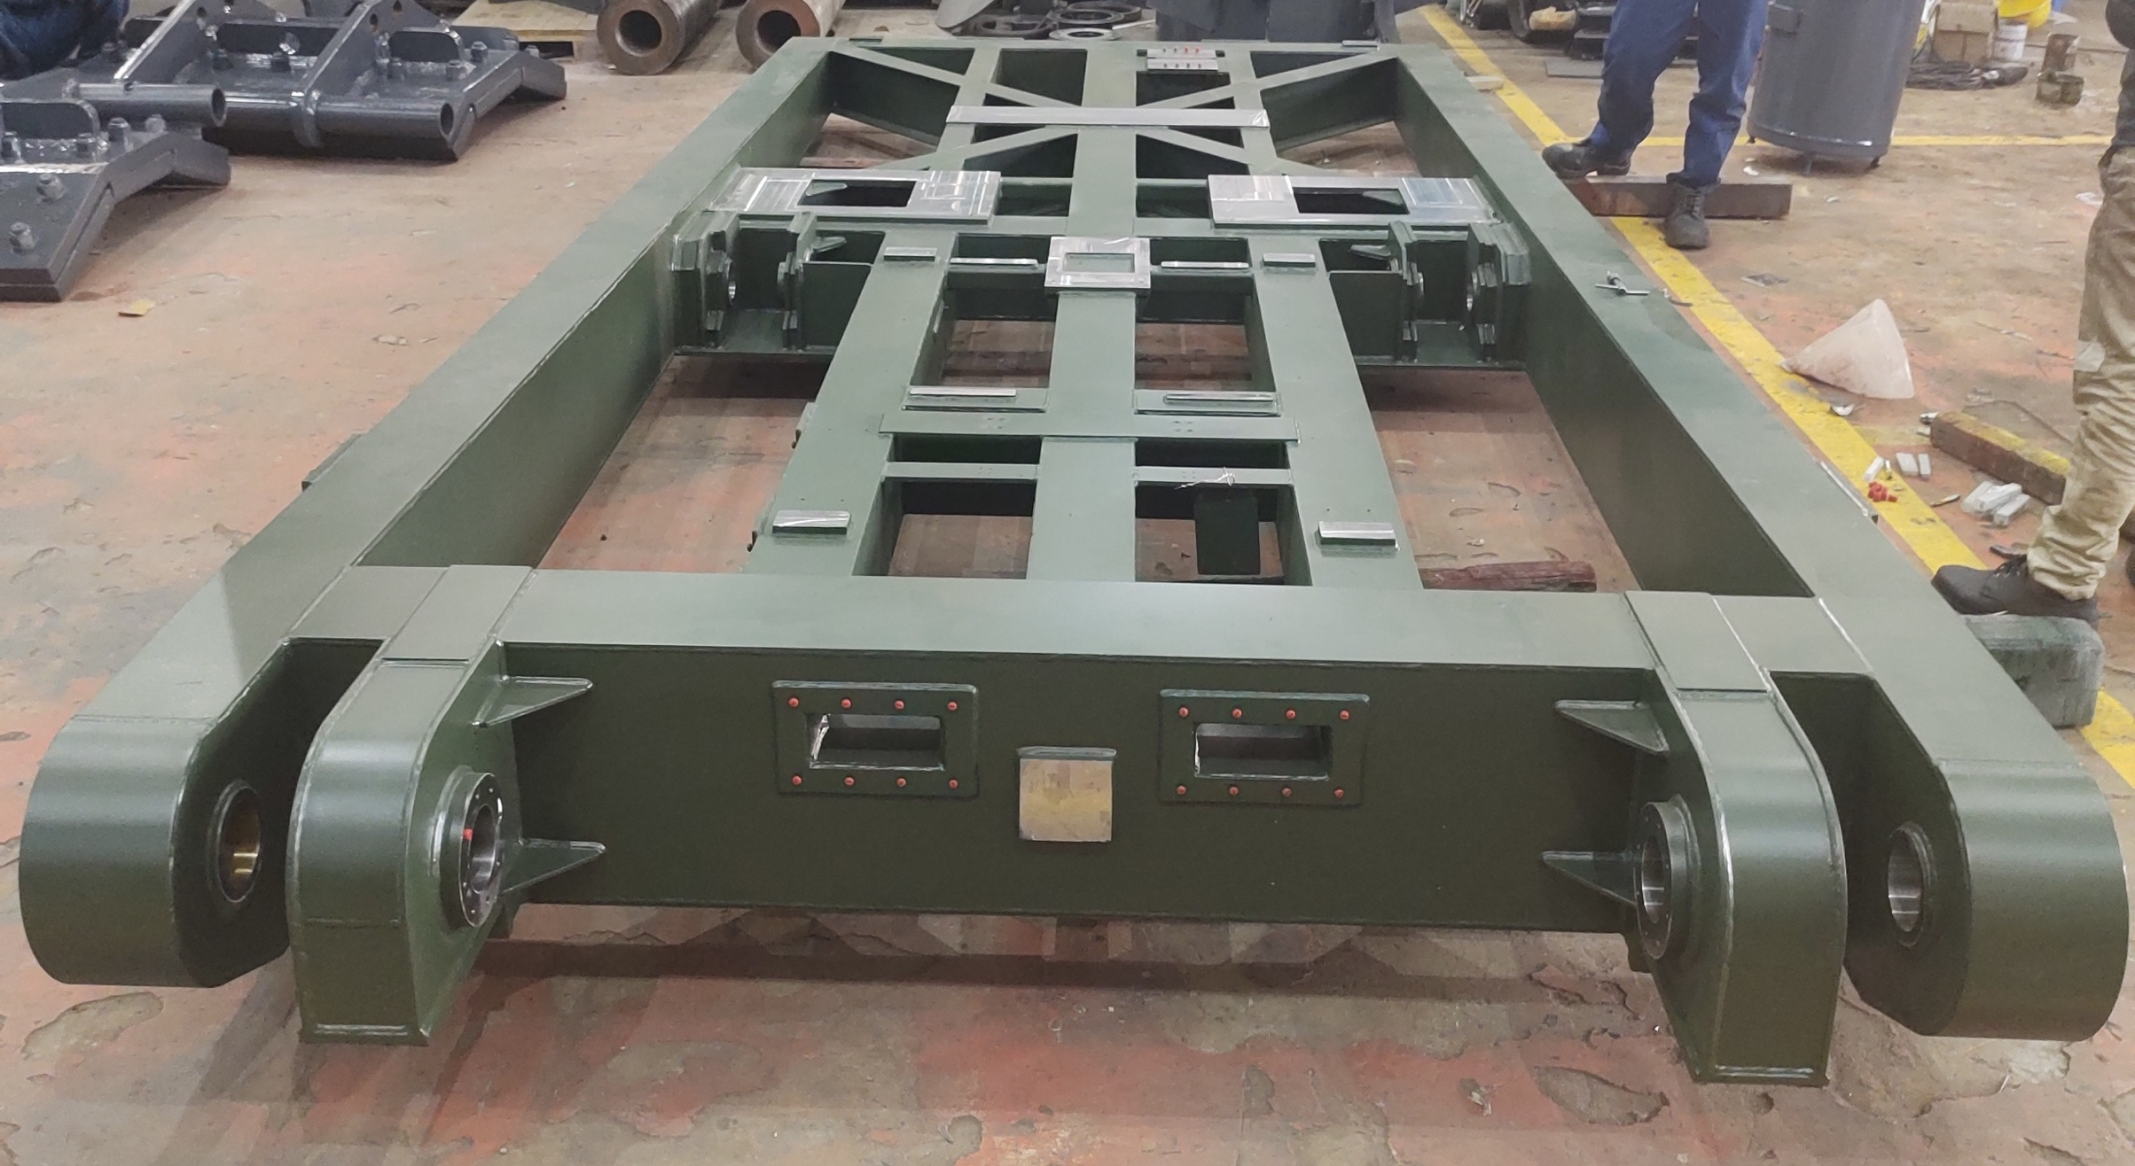
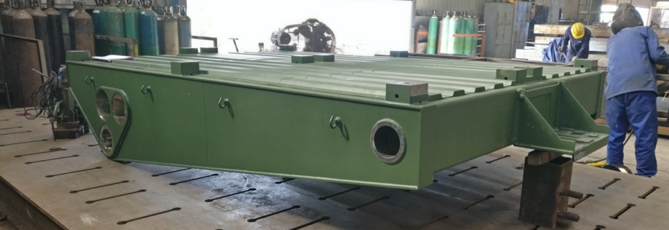
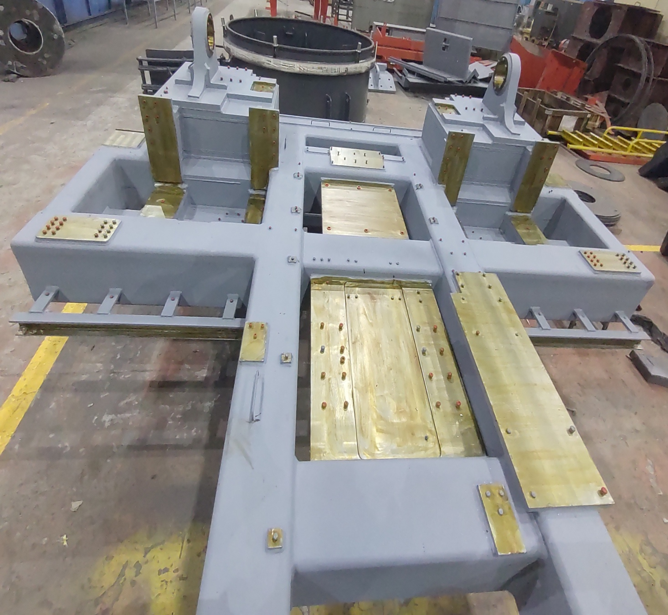
AIM Engineers India Pvt Ltd
Back
Exit
Home
About Us
Facility
Portfolio
Clientele
Indian Defense Structures

Slide 41
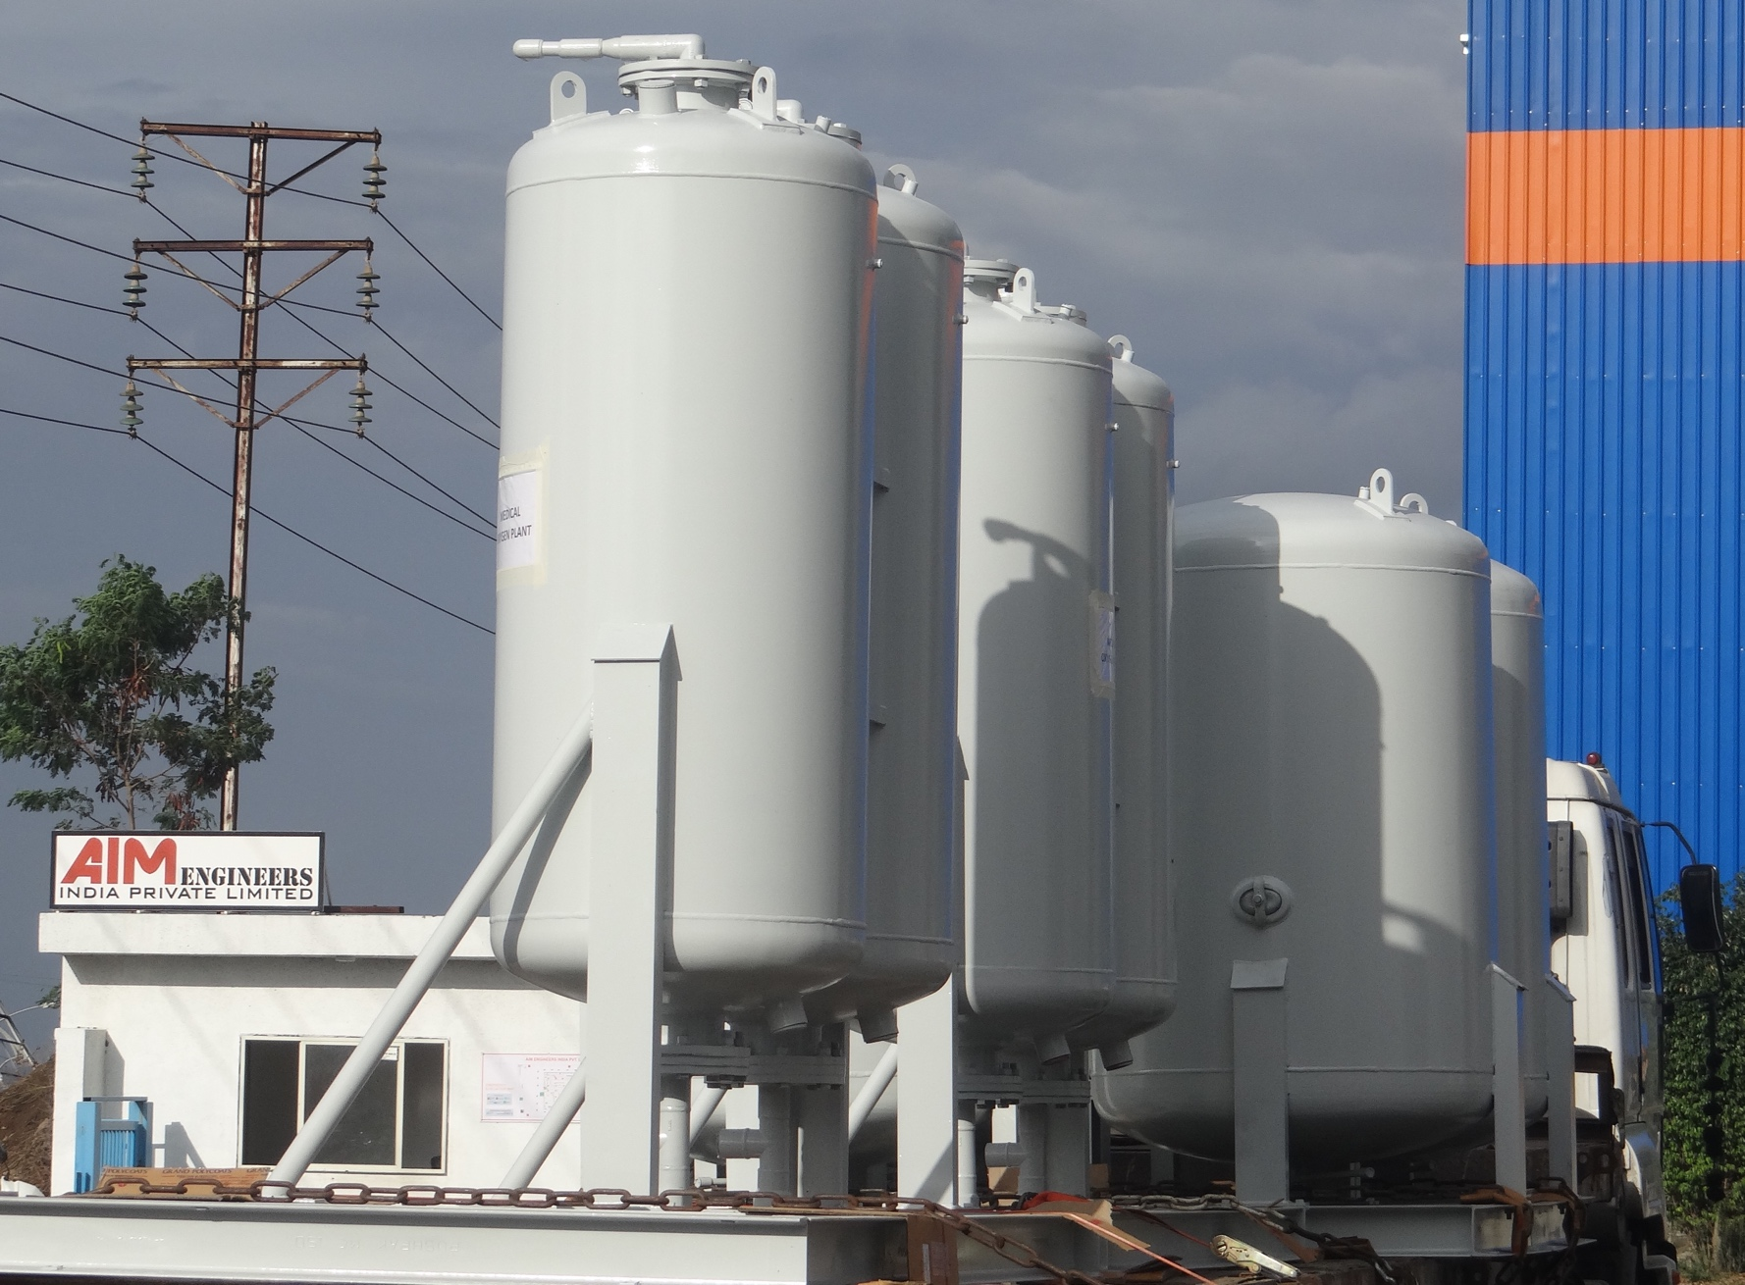
AIM Engineers India Pvt Ltd
Exit
Home
About Us
Facility
Portfolio
Clientele
Medical Oxygen Plant

Slide 42













AIM Engineers India Pvt Ltd
Exit
Home
About Us
Facility
Portfolio
Clientele

Slide 43
AIM Engineers India Pvt Ltd
Exit
Home
About Us
Facility
Portfolio
Clientele
Thank You

